Slide 1
Share-Hub
A Document Sharing Platform.
Prepared By: Gohil Kapil

Slide 2
Content
Overview
Key Features
Tools, Technology And Platform Used
Demonstration of project
Conclusion
Limitations
References

Slide 3
Overview
The purpose of this project is to streamline the process of document sharing among users, addressing the need for efficient and secure sharing while maintaining control over access rights.
In various scenarios, users often find themselves in situations where they must share materials or documents with others but wish to restrict access to certain individuals or groups. Recognizing these challenges, the Share-Hub developed, an innovative online document sharing platform.
Share-Hub offers users the ability to create, upload, and share materials with friends, colleagues, or collaborators seamlessly.
The primary objective of Share-Hub is to provide users with a user-friendly and intuitive platform for sharing various documents and files without encountering the complexities often associated with traditional file-sharing methods.

Slide 4
Overview
By simplifying the sharing process and enhancing security measures, Share-Hub aims to facilitate seamless collaboration and information exchange among users.
Overall, Share-Hub is all about making it easy for people to share and manage their documents online and in simple way.

Slide 5
Key Features
User Management (Login/Register/Password Recovery)
Document Create
File/s Upload, Download and Delete
Document Sharing
Comments
Access Control
Notifications
User Friendly Interfaces

Slide 6
Tools, Technology And Platform Used
Share-Hub was built using the MERN stack, which is a popular technology stack for developing full-stack web applications.
MongoDB serves as the NoSQL database, chosen for its flexibility and scalability.
Express.js simplifies web application development by handling routing and server-side logic.
React.js powers the client-side interface with its component-based architecture, offering users a responsive experience.
Node.js, as the runtime environment, manages backend infrastructure and interacts with MongoDB.
WebStorm IDE, developed by JetBrains, was chosen as the integrated development environment (IDE) for building Share-Hub.

Slide 7
Tools, Technology And Platform Used
Firebase was utilized for document storing purposes within Share-Hub. Firebase offers a scalable and flexible cloud-based platform for storing and syncing data across devices, making it an ideal choice for document management within the application.

Slide 8
Demonstration of Share-Hub

Slide 9
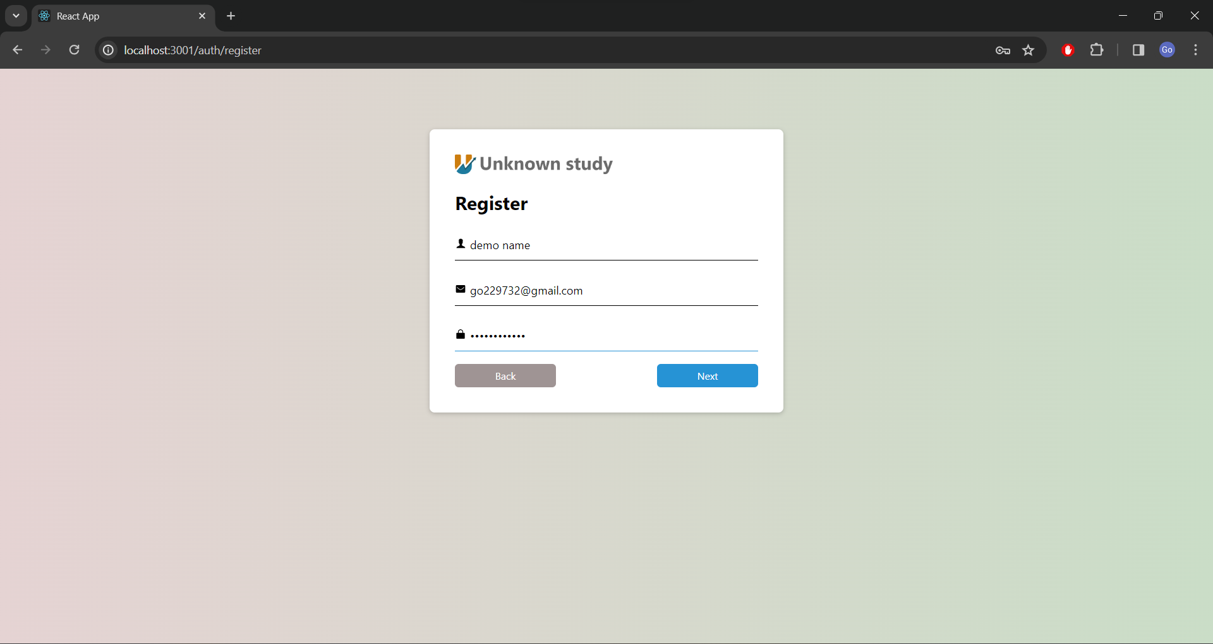

Slide 10
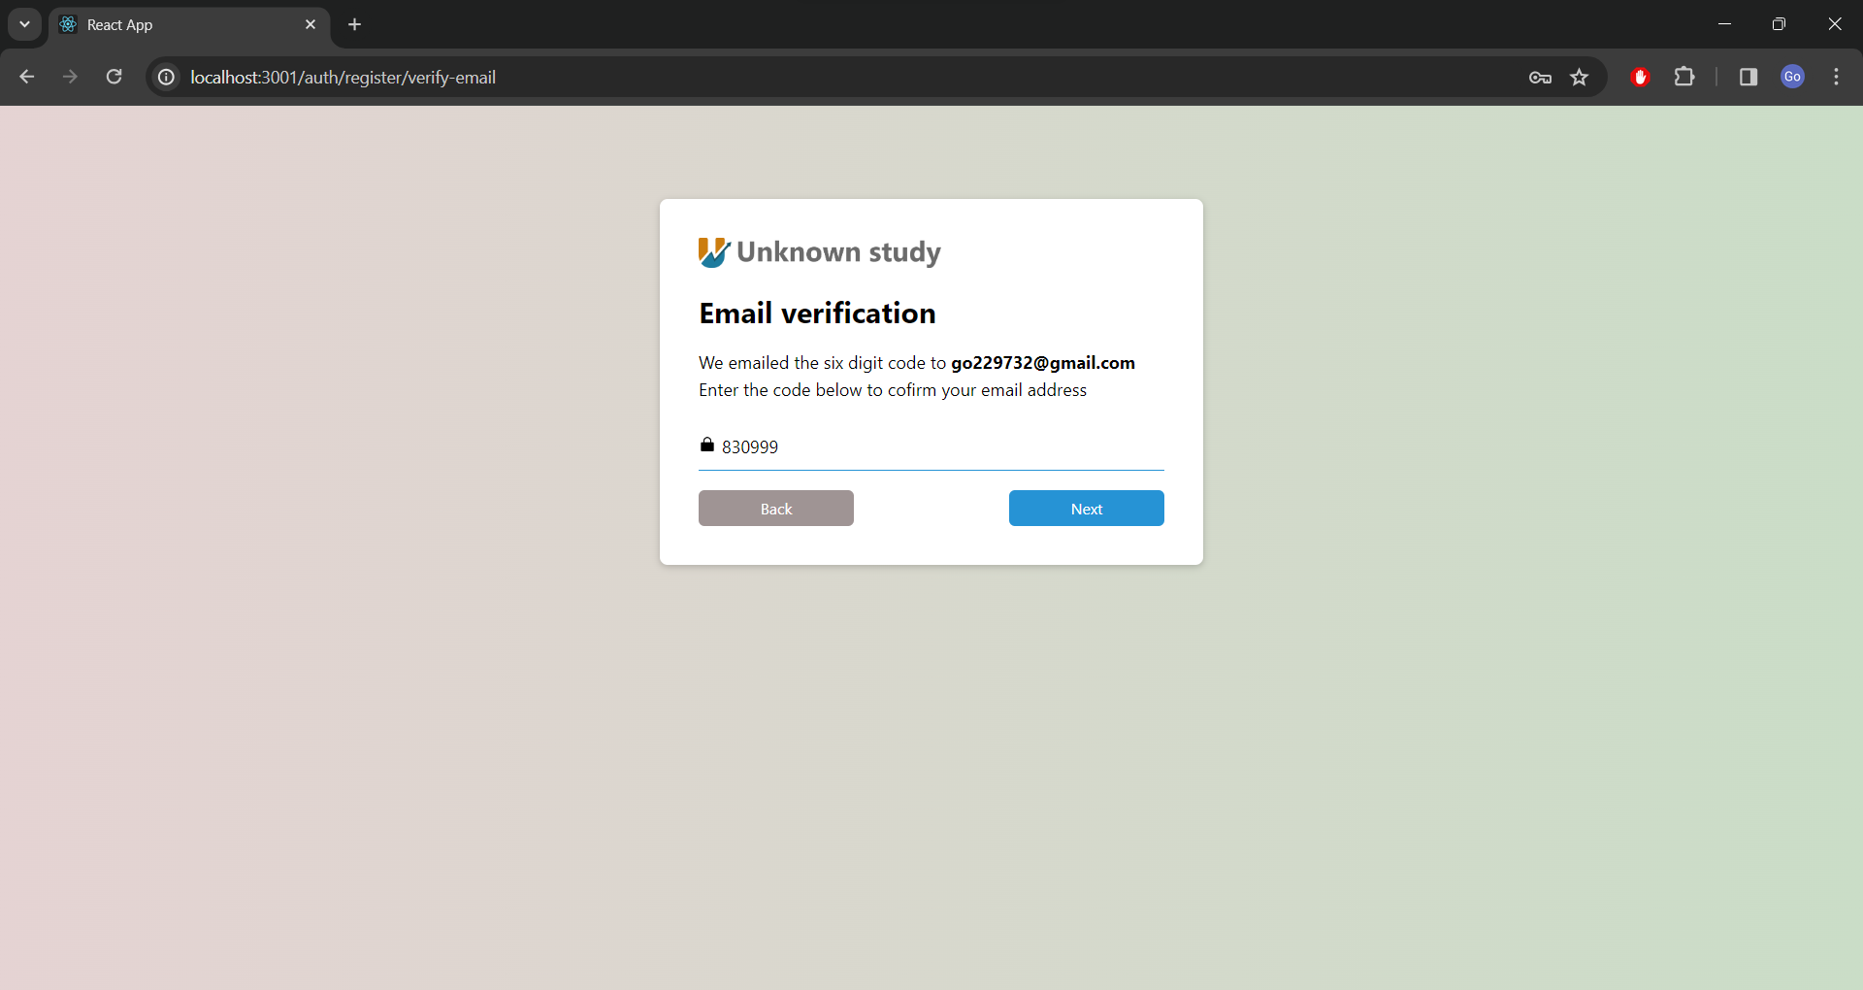

Slide 11
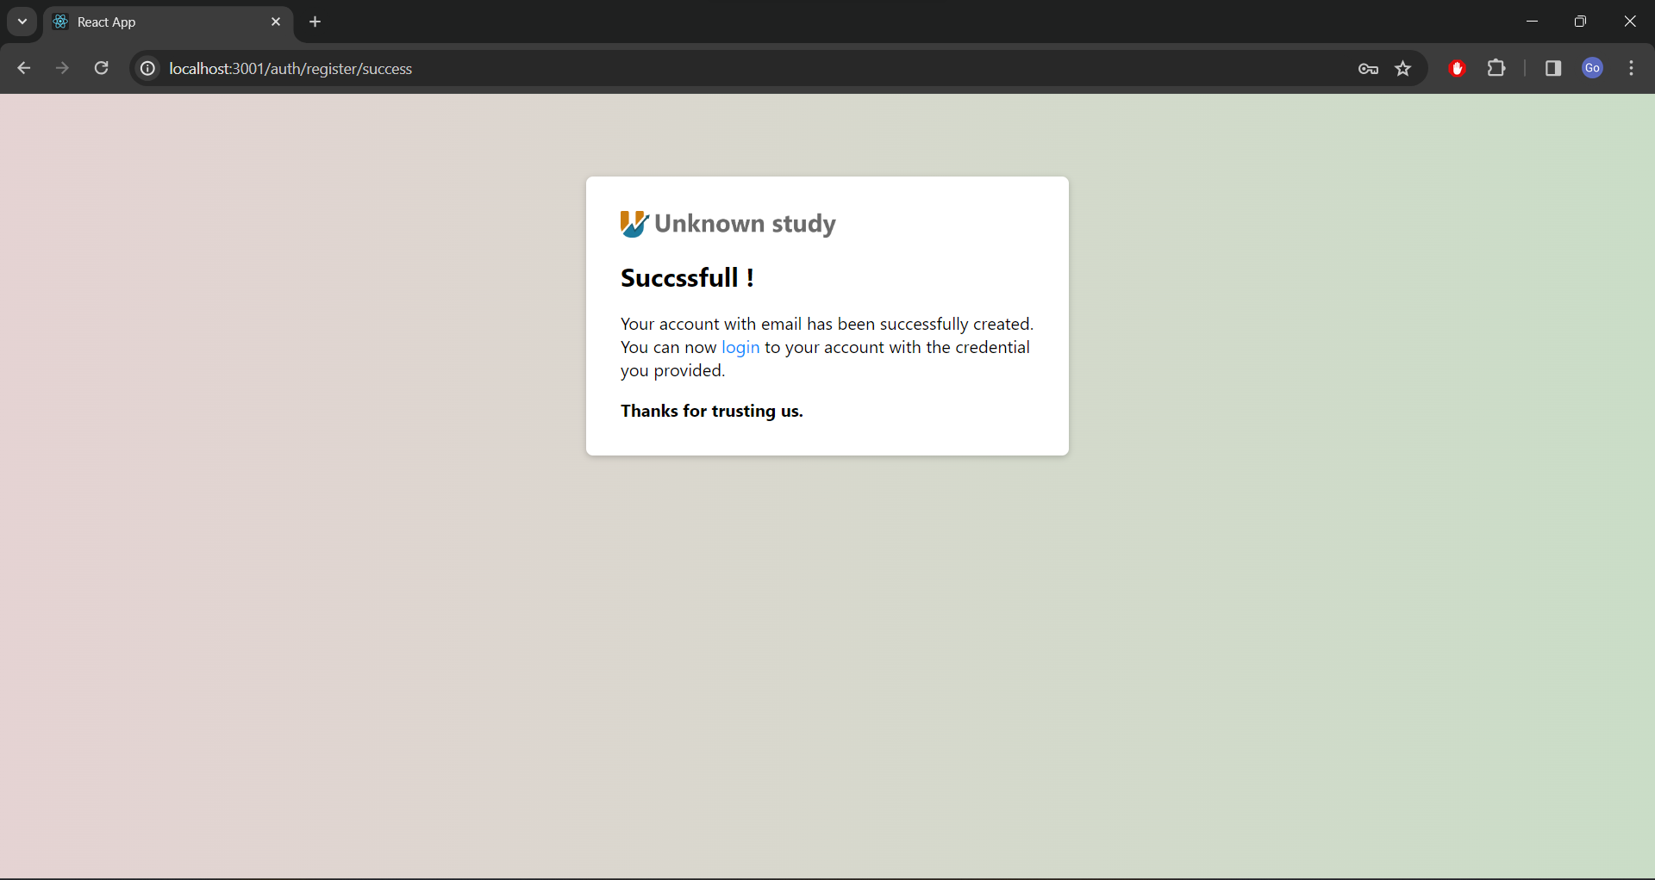

Slide 12
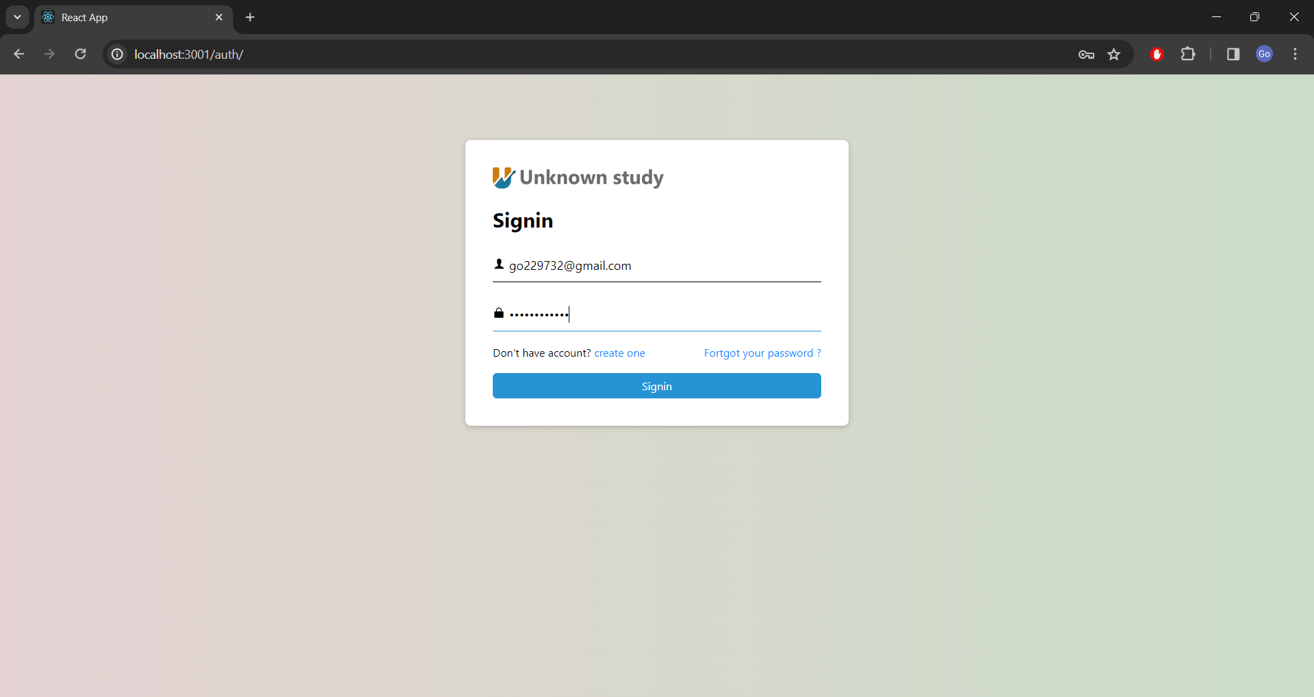

Slide 13
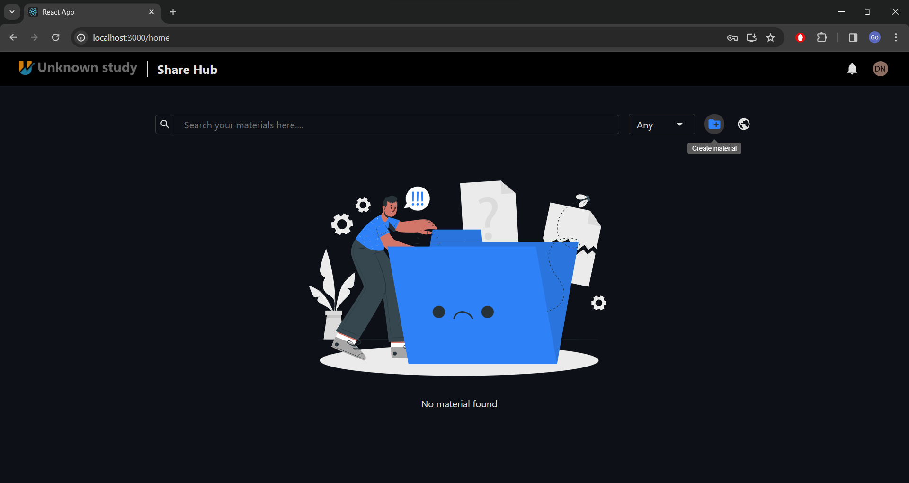

Slide 14
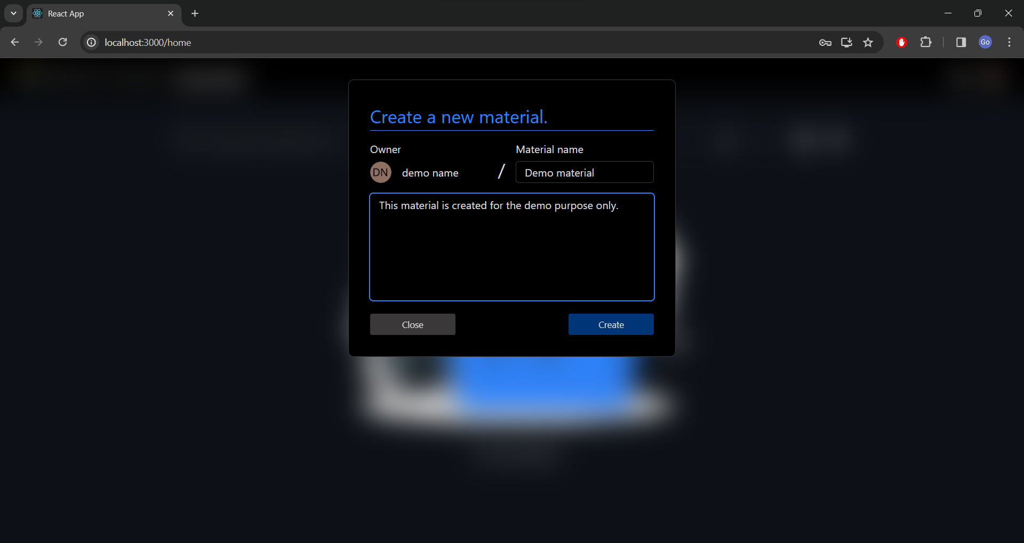

Slide 15
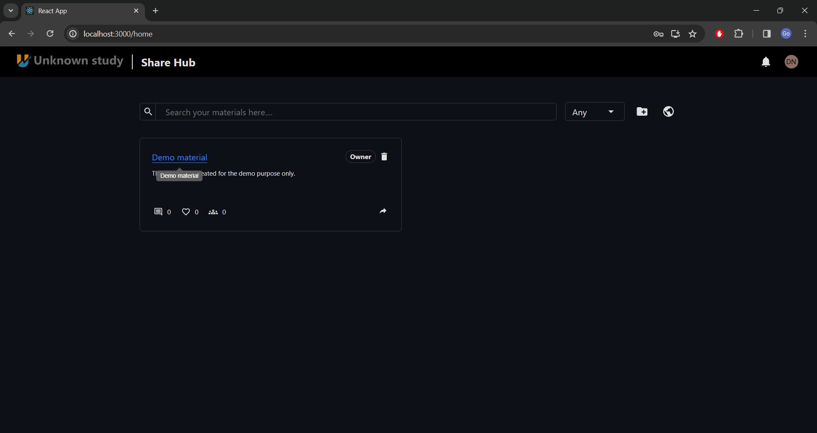

Slide 16
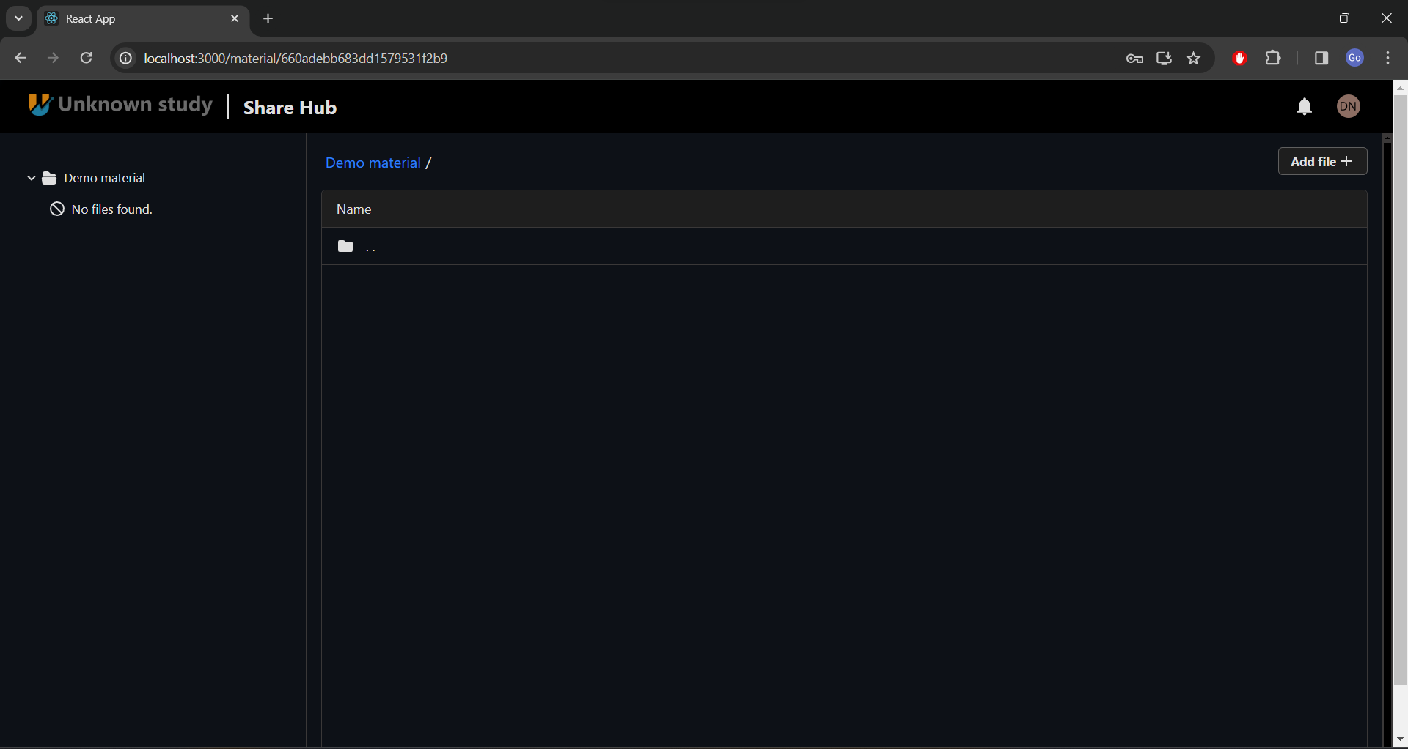

Slide 17
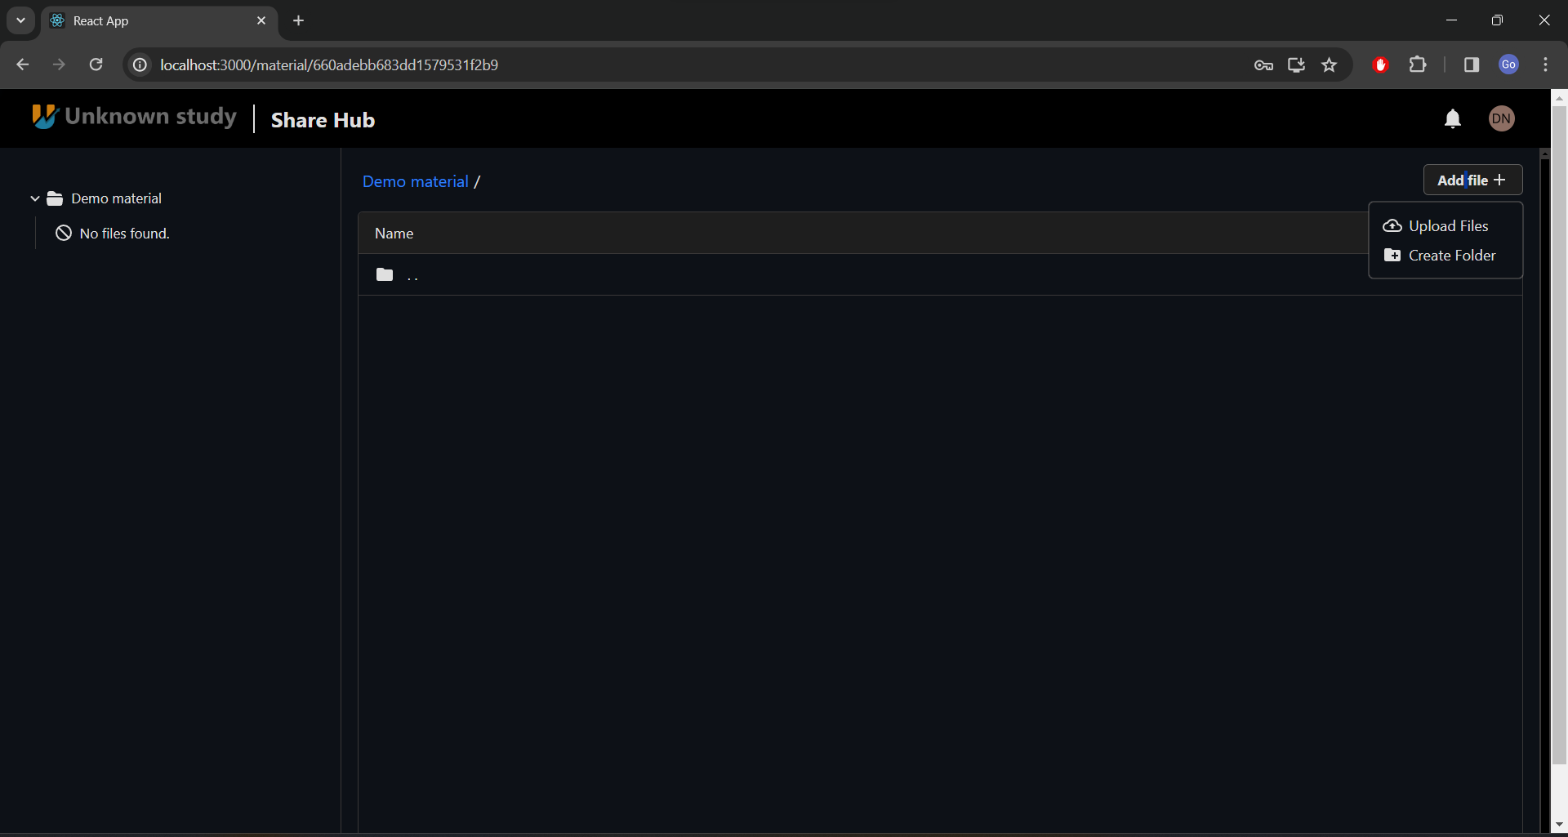

Slide 18
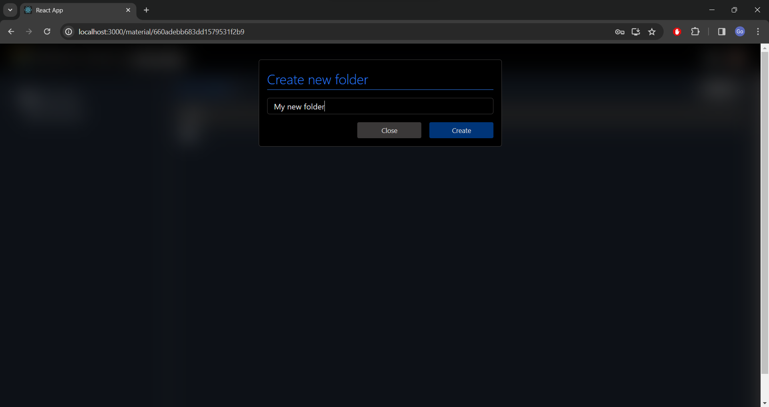

Slide 19
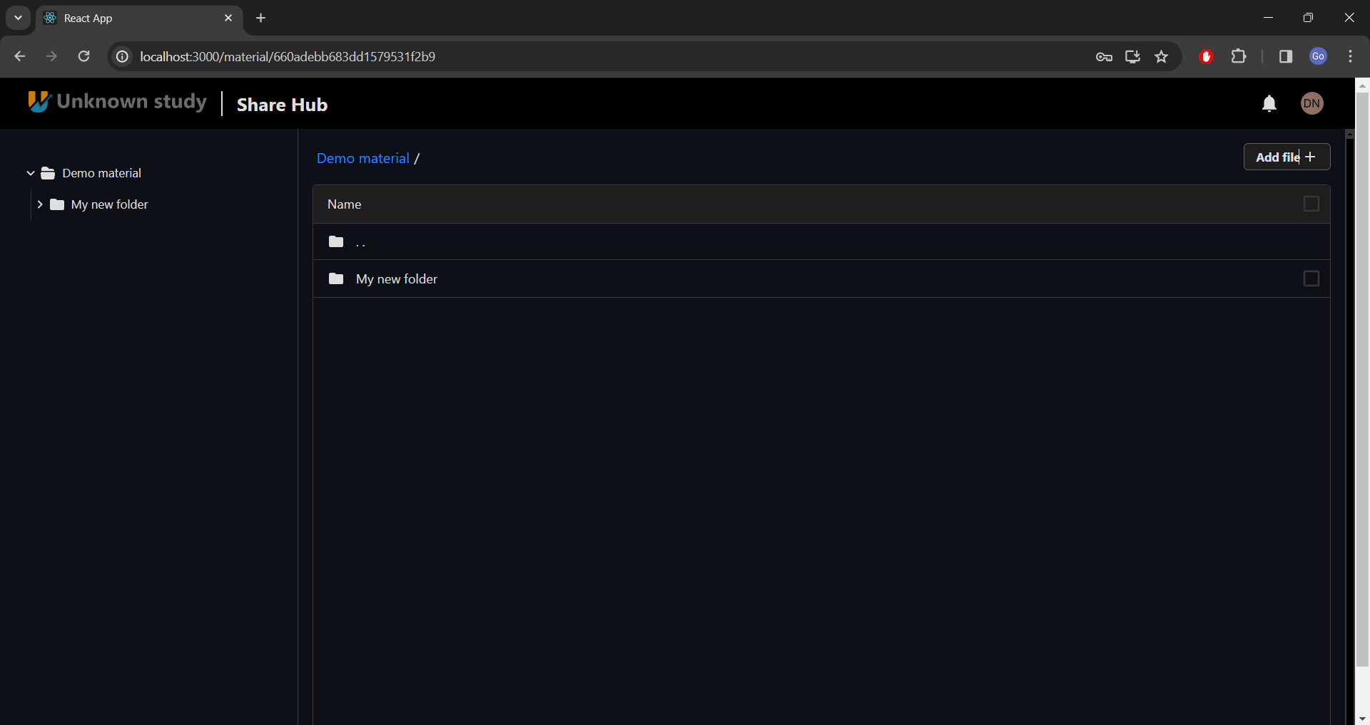

Slide 20
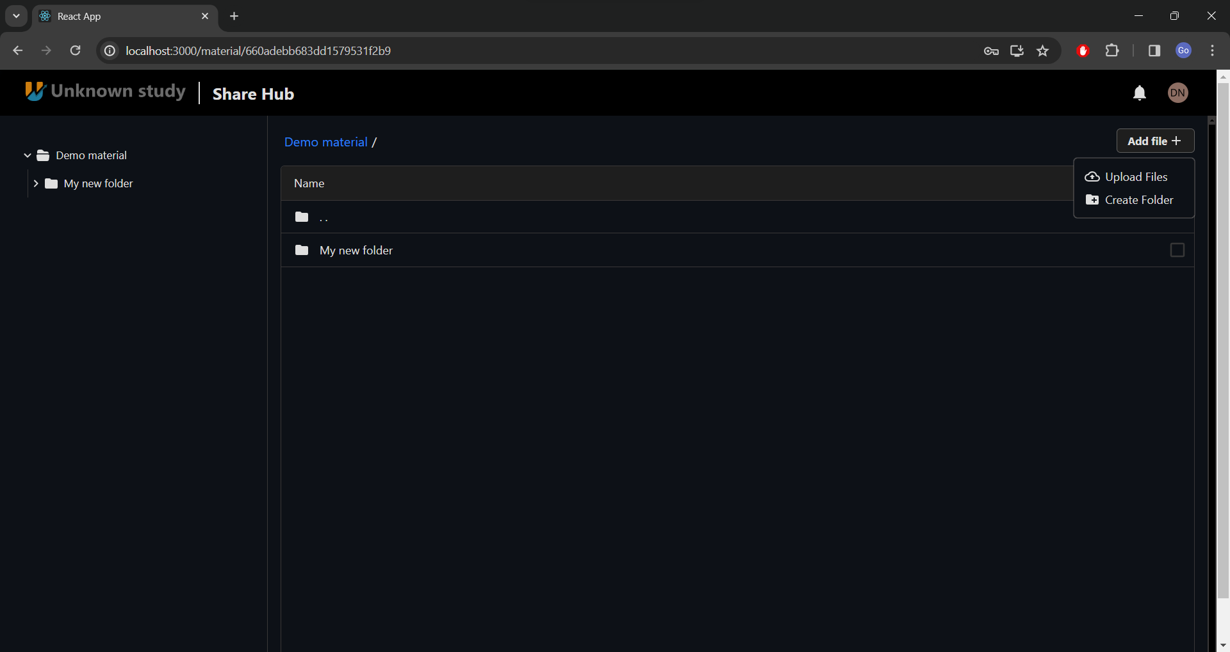

Slide 21
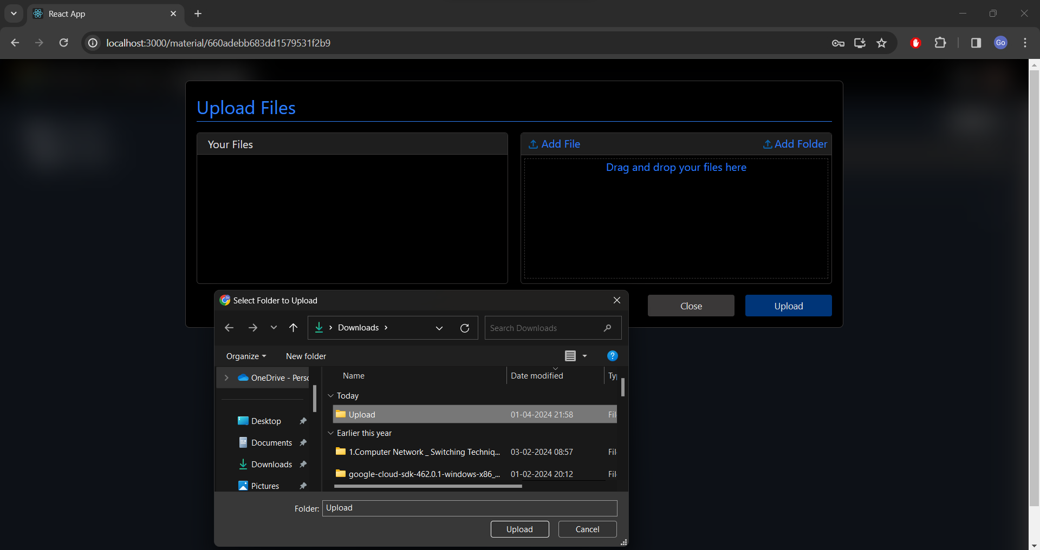

Slide 22
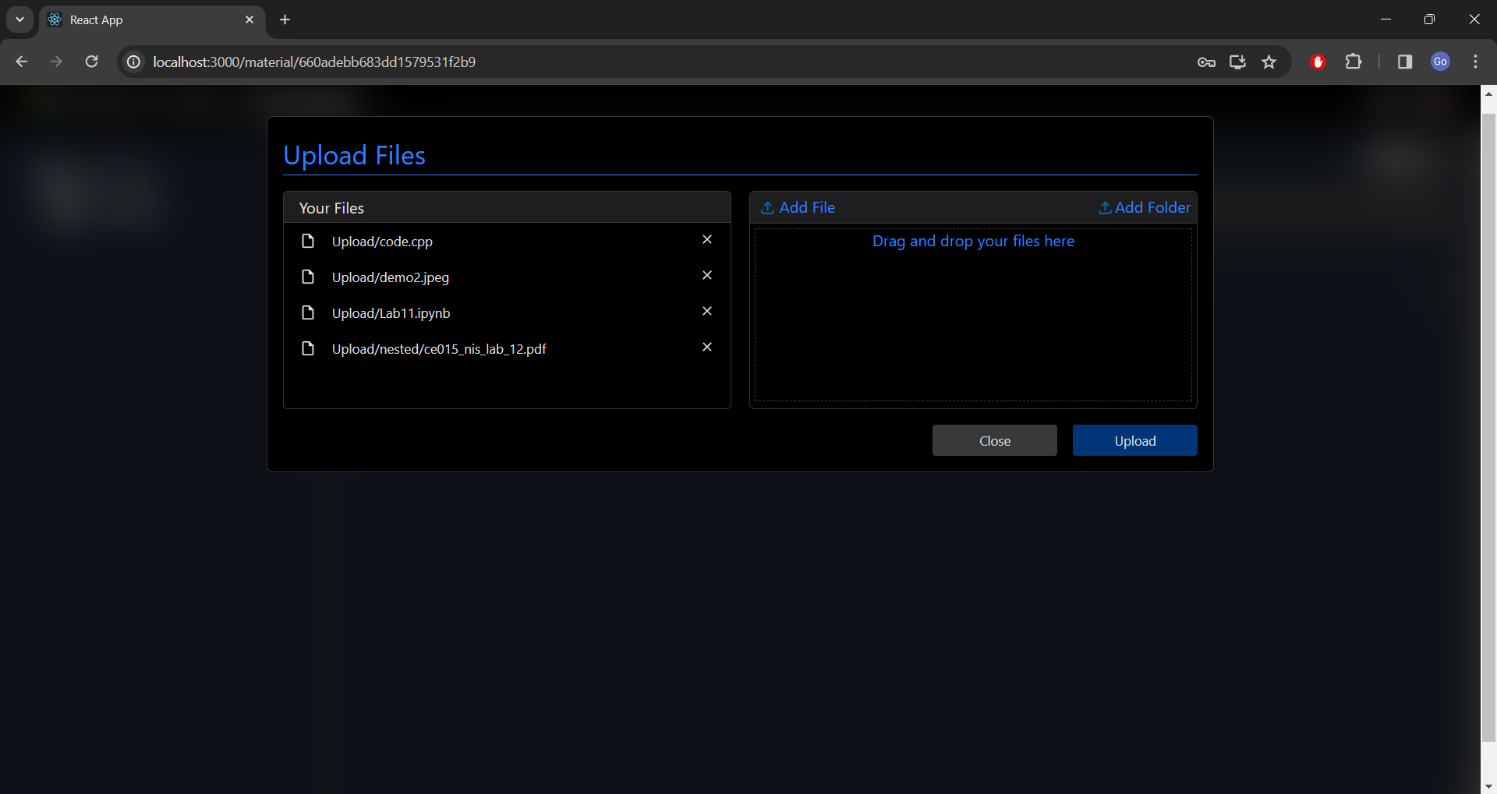

Slide 23
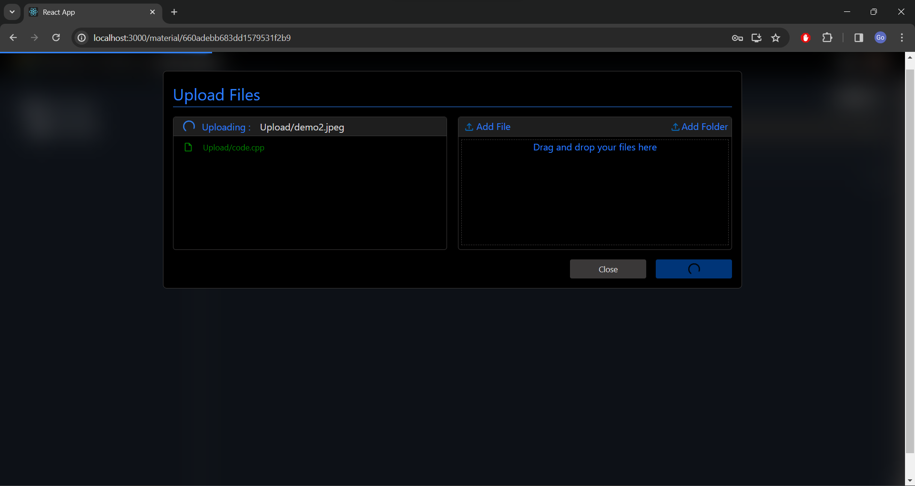

Slide 24
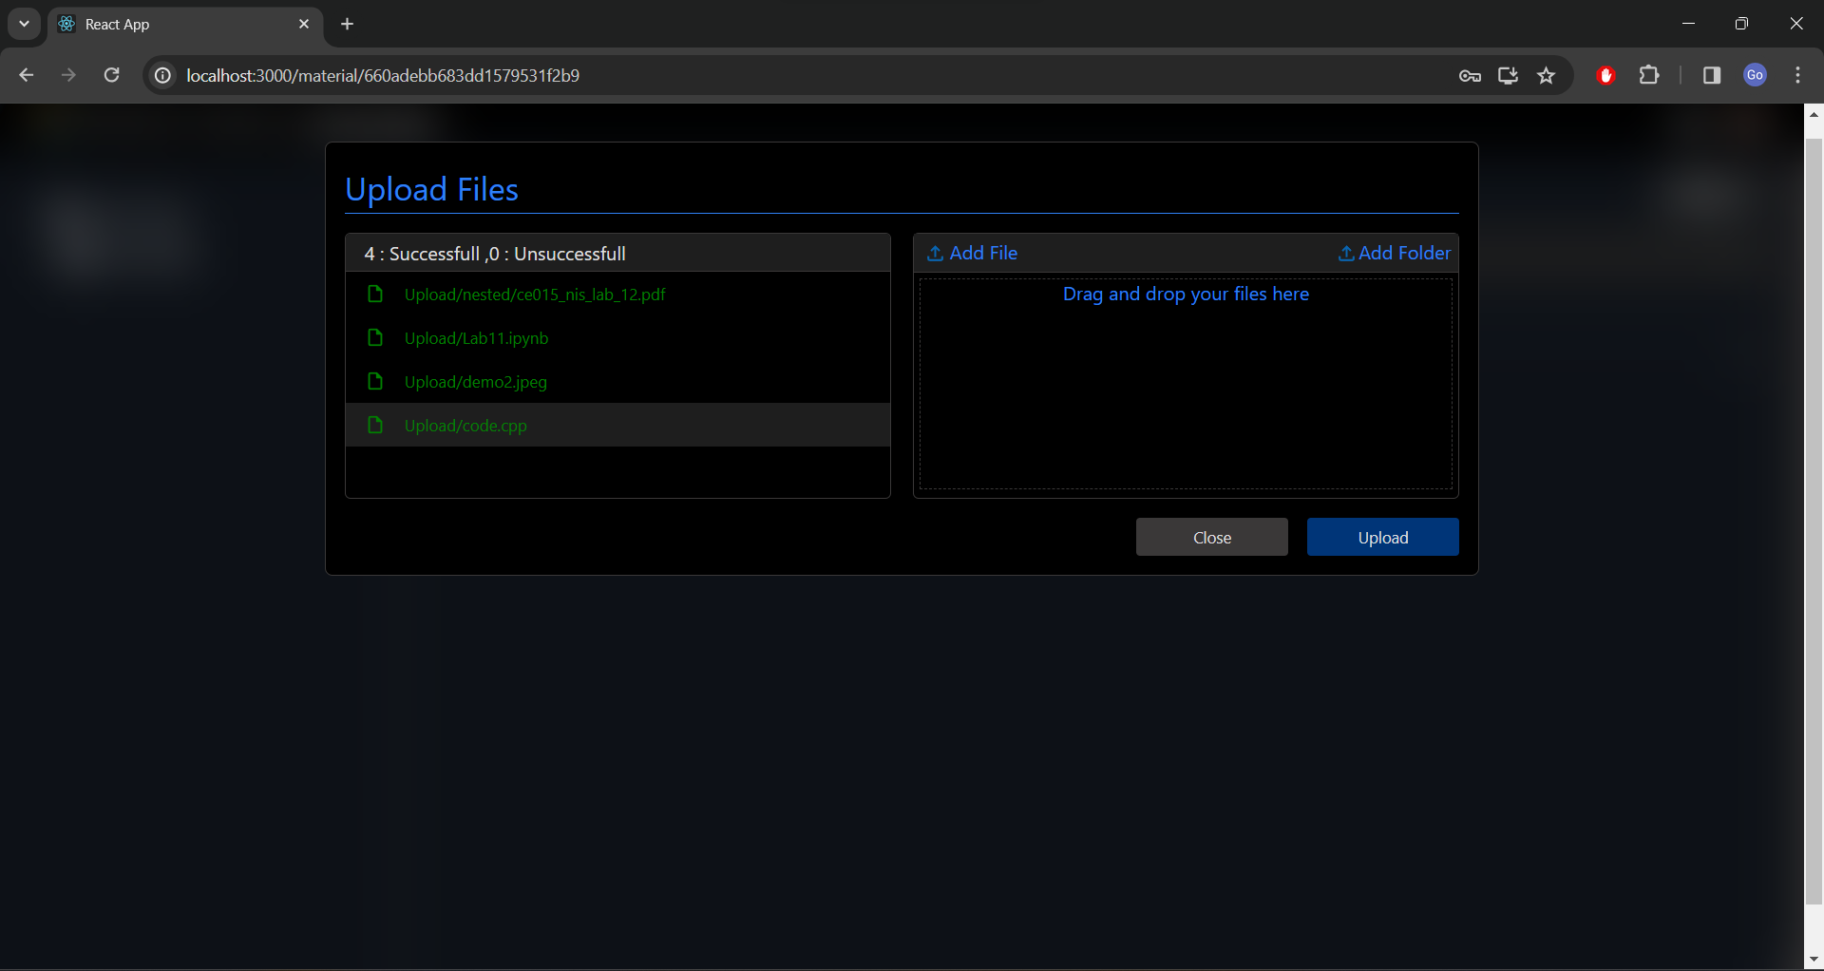

Slide 25
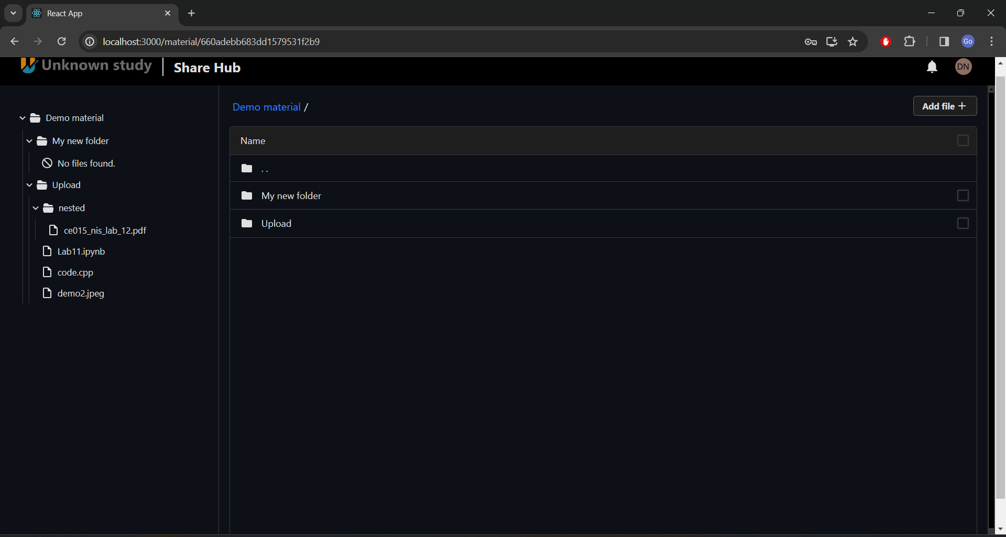

Slide 26
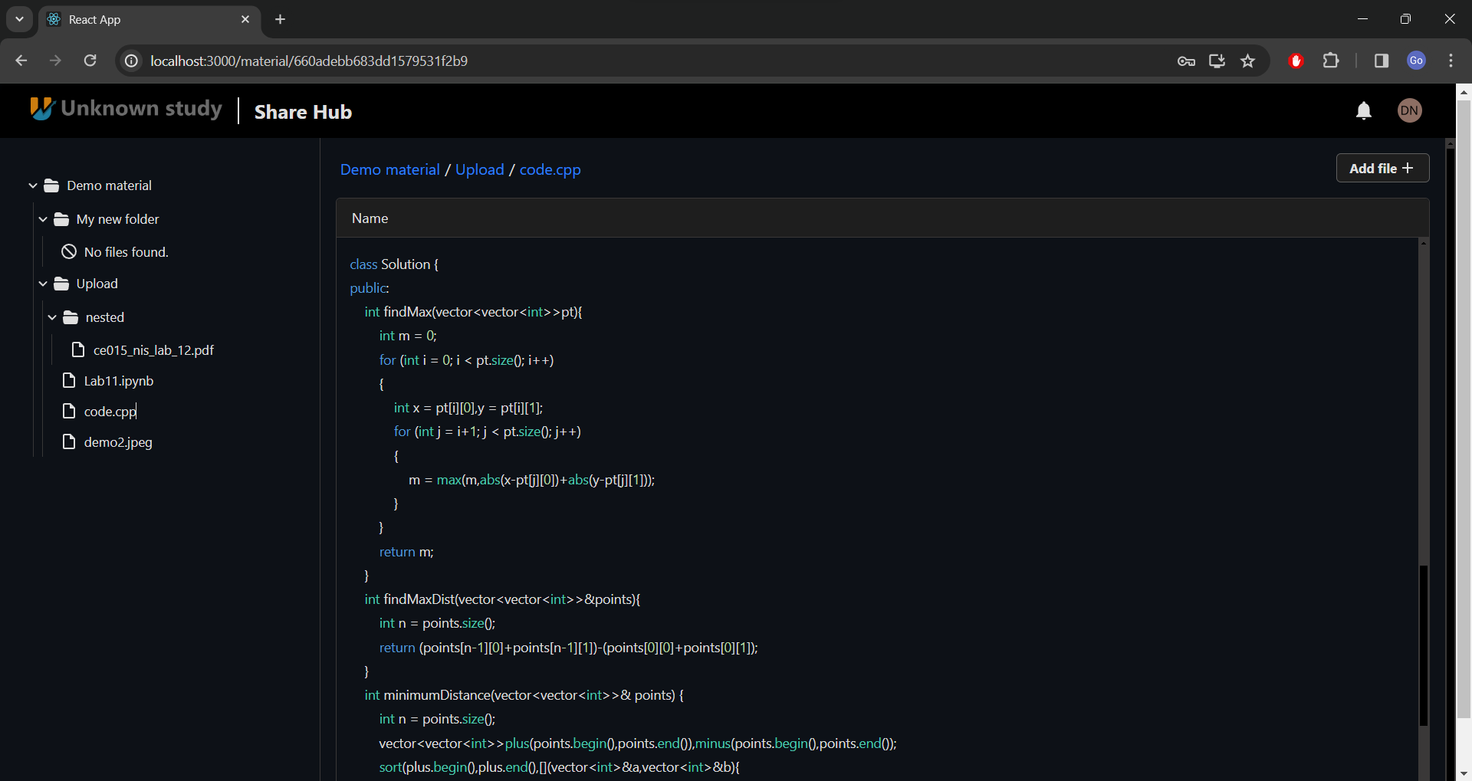

Slide 27
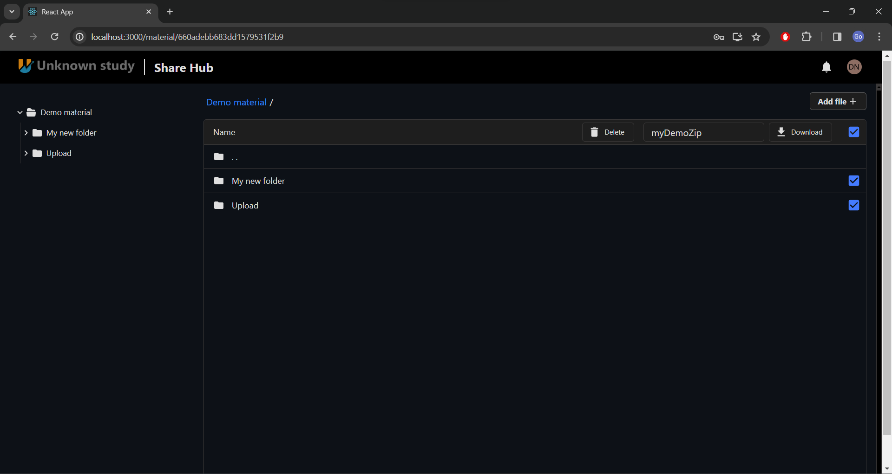

Slide 28
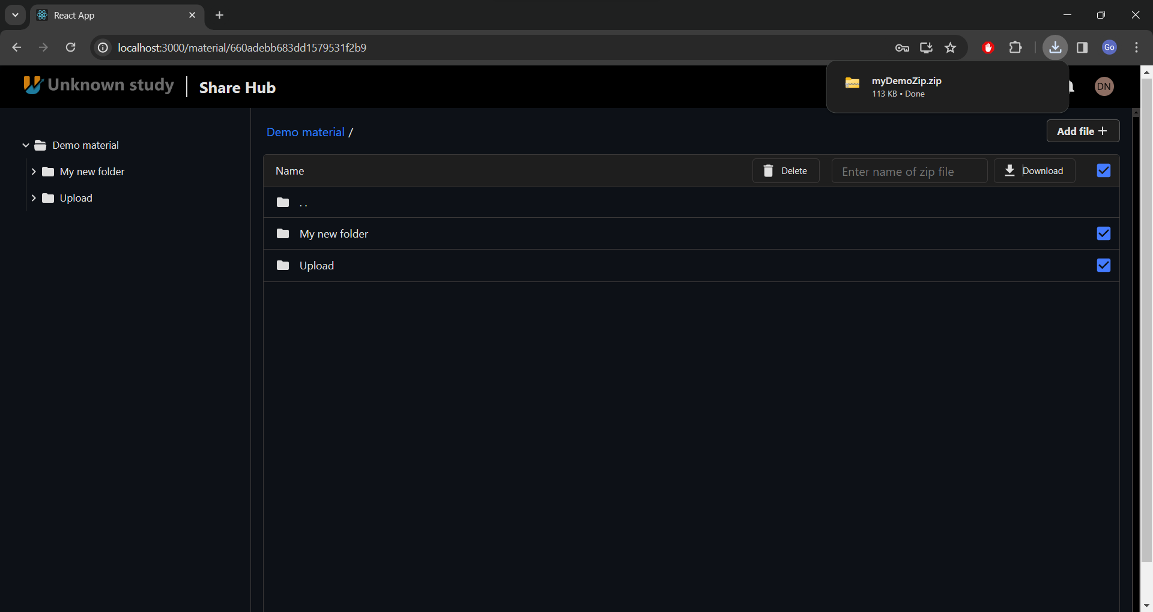

Slide 29
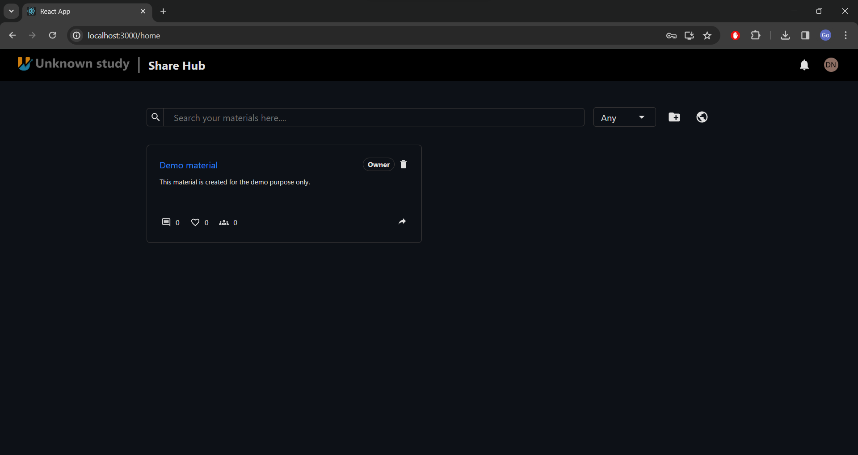

Slide 30
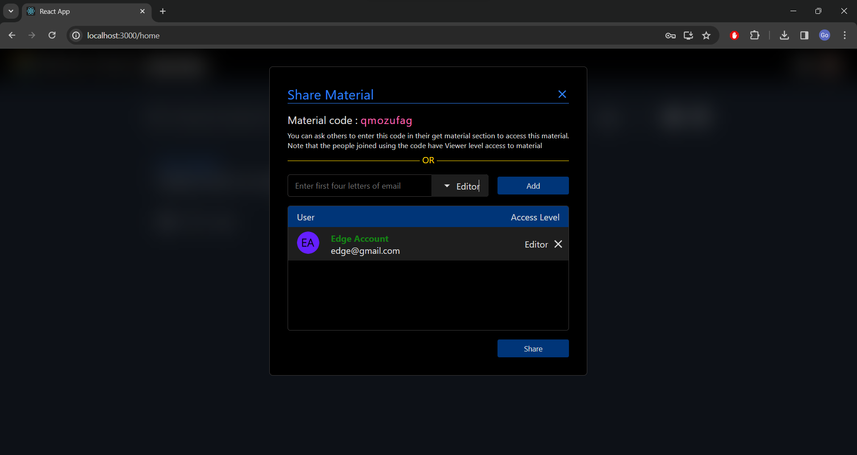

Slide 31
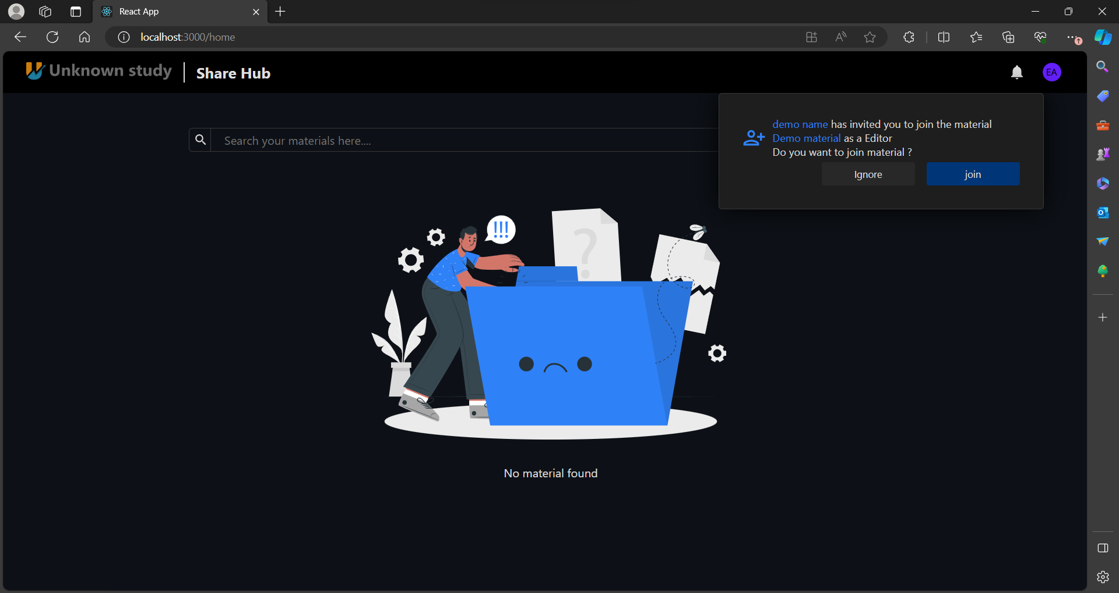

Slide 32
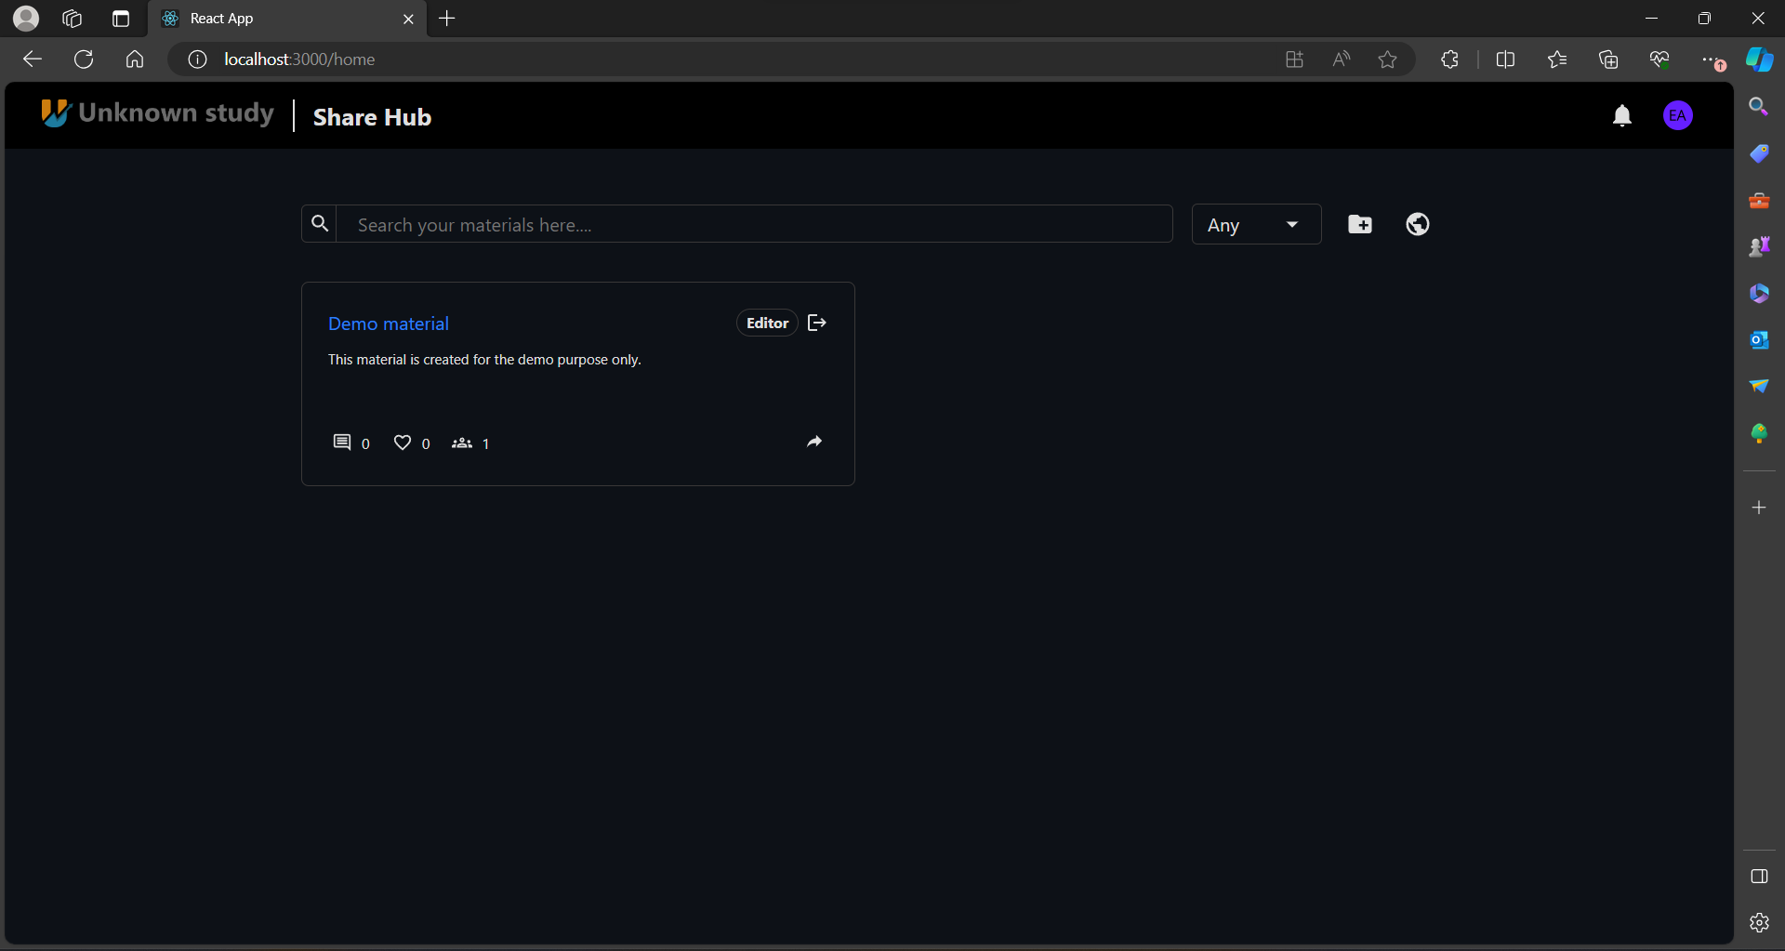

Slide 33
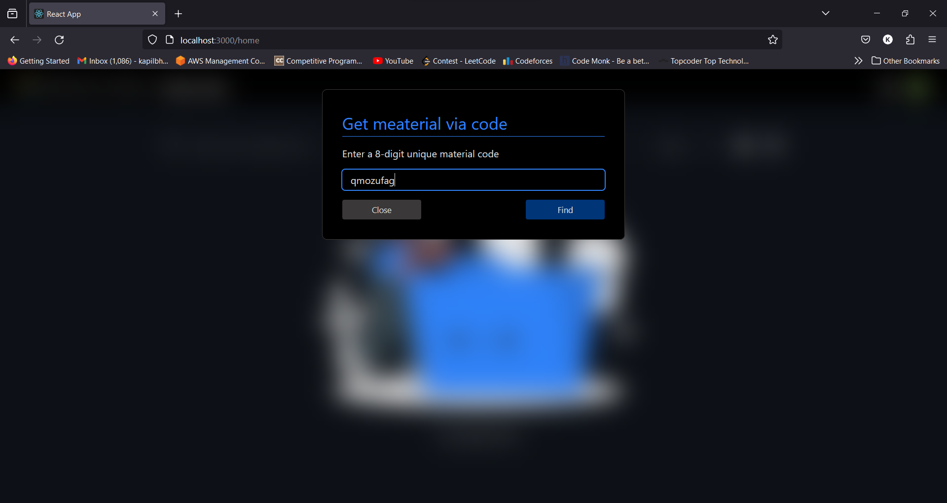

Slide 34
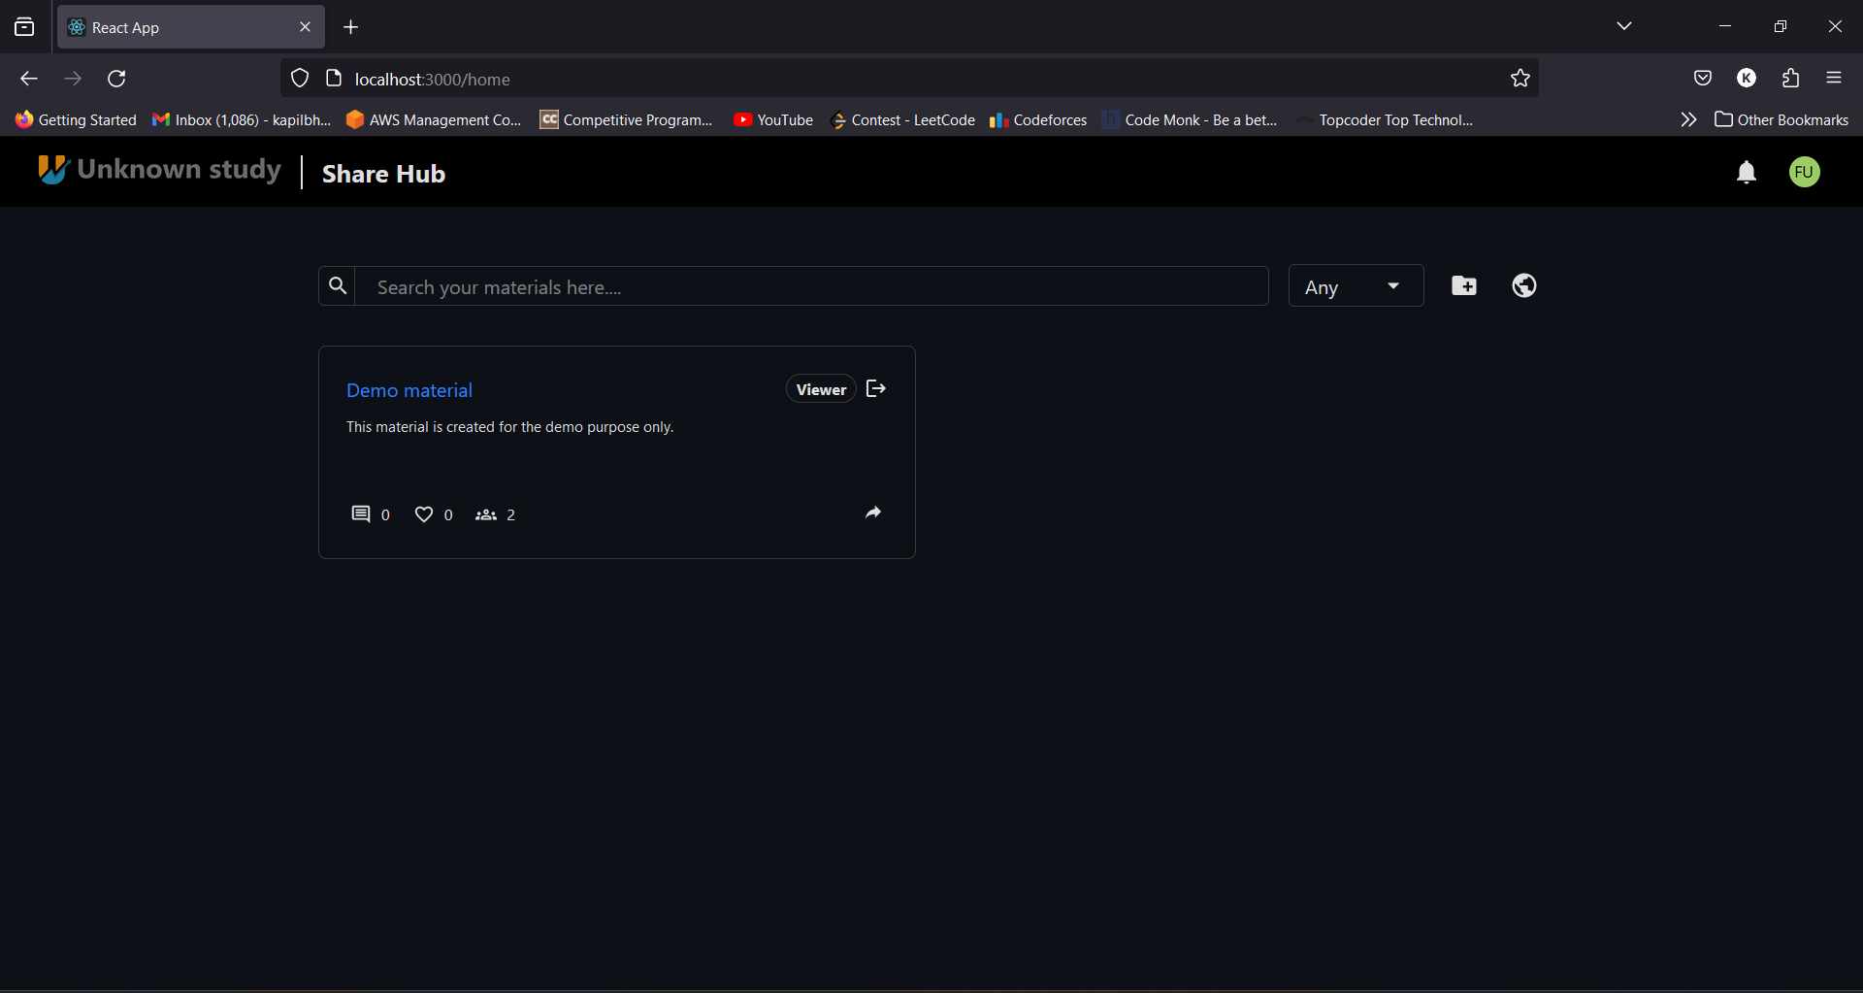

Slide 35
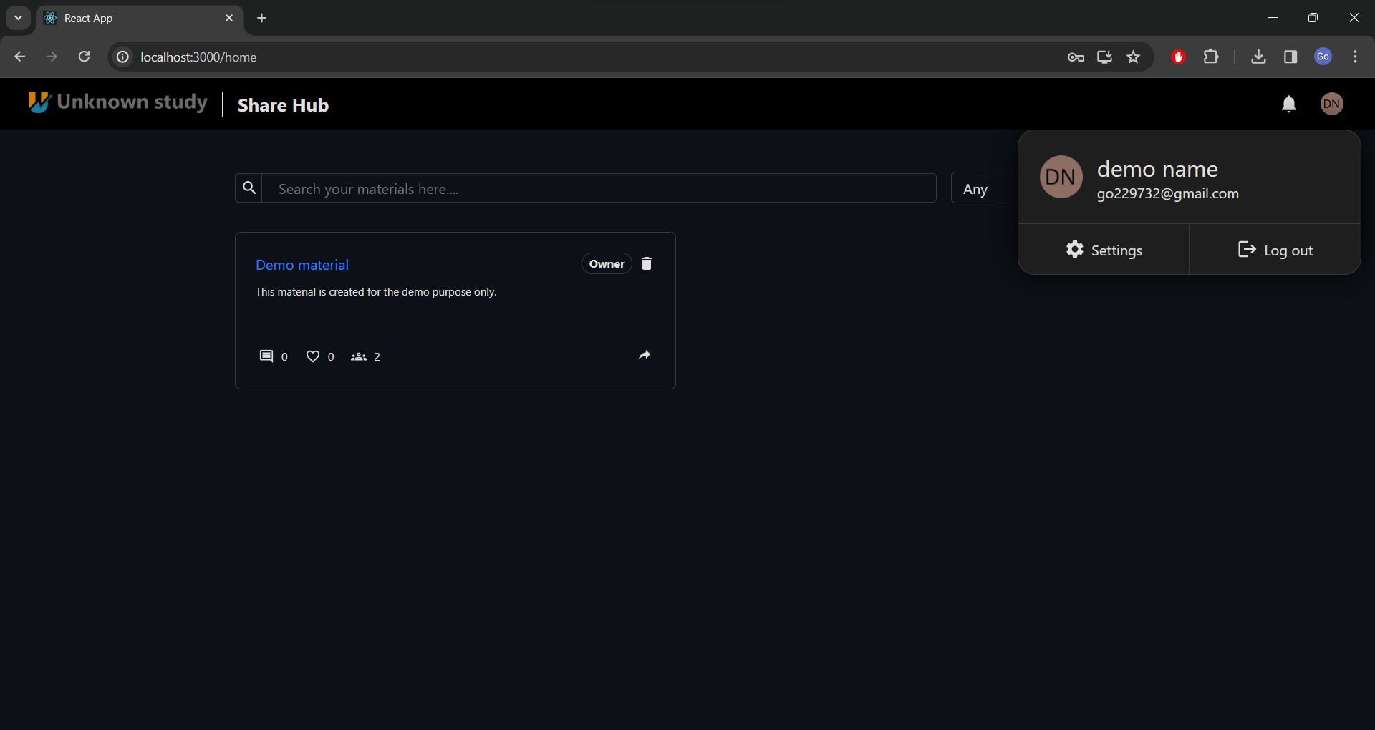

Slide 36
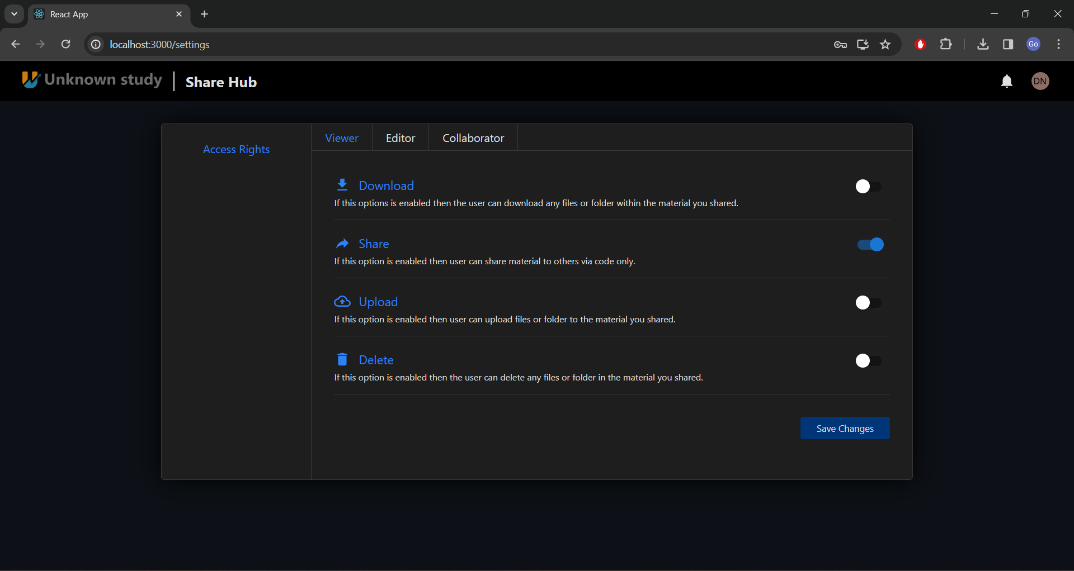

Slide 37


Slide 38
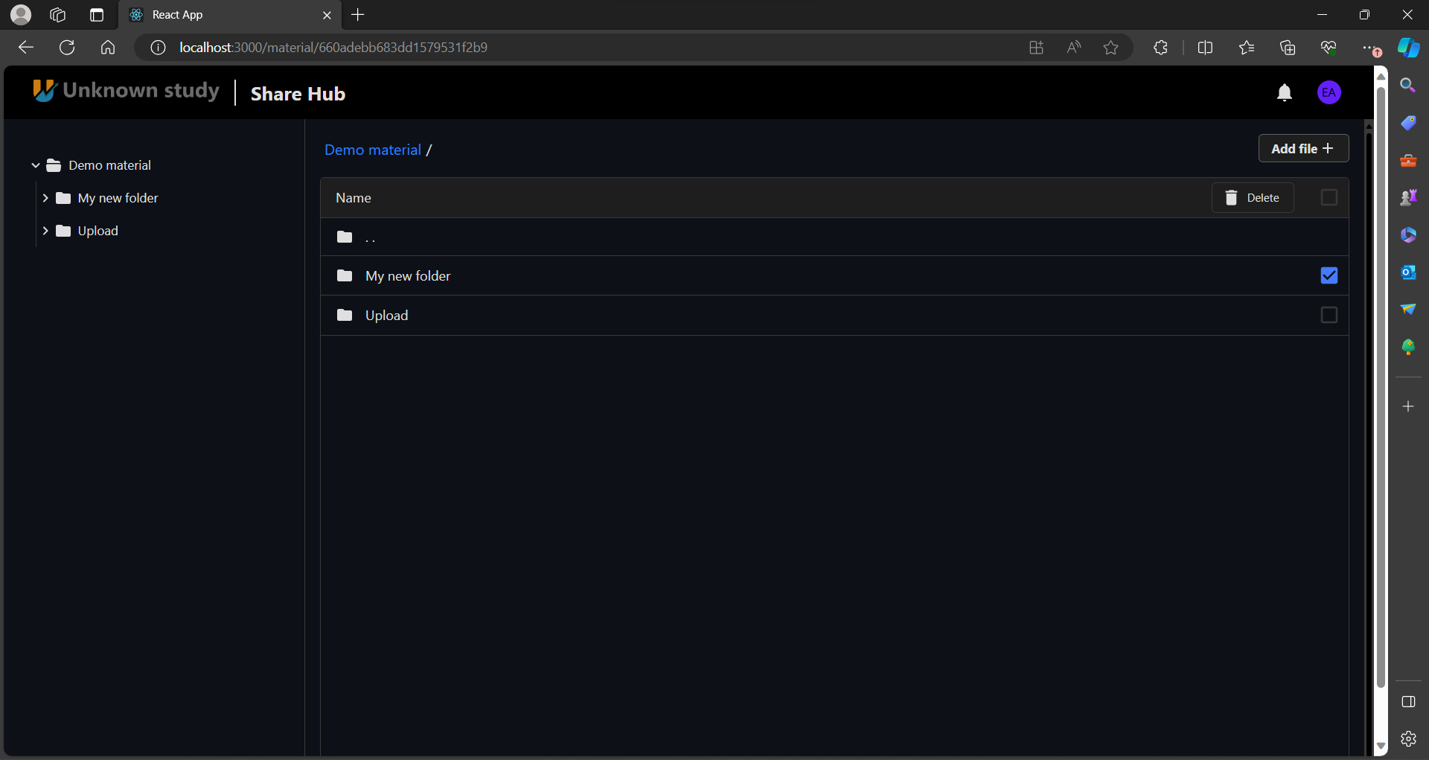

Slide 39
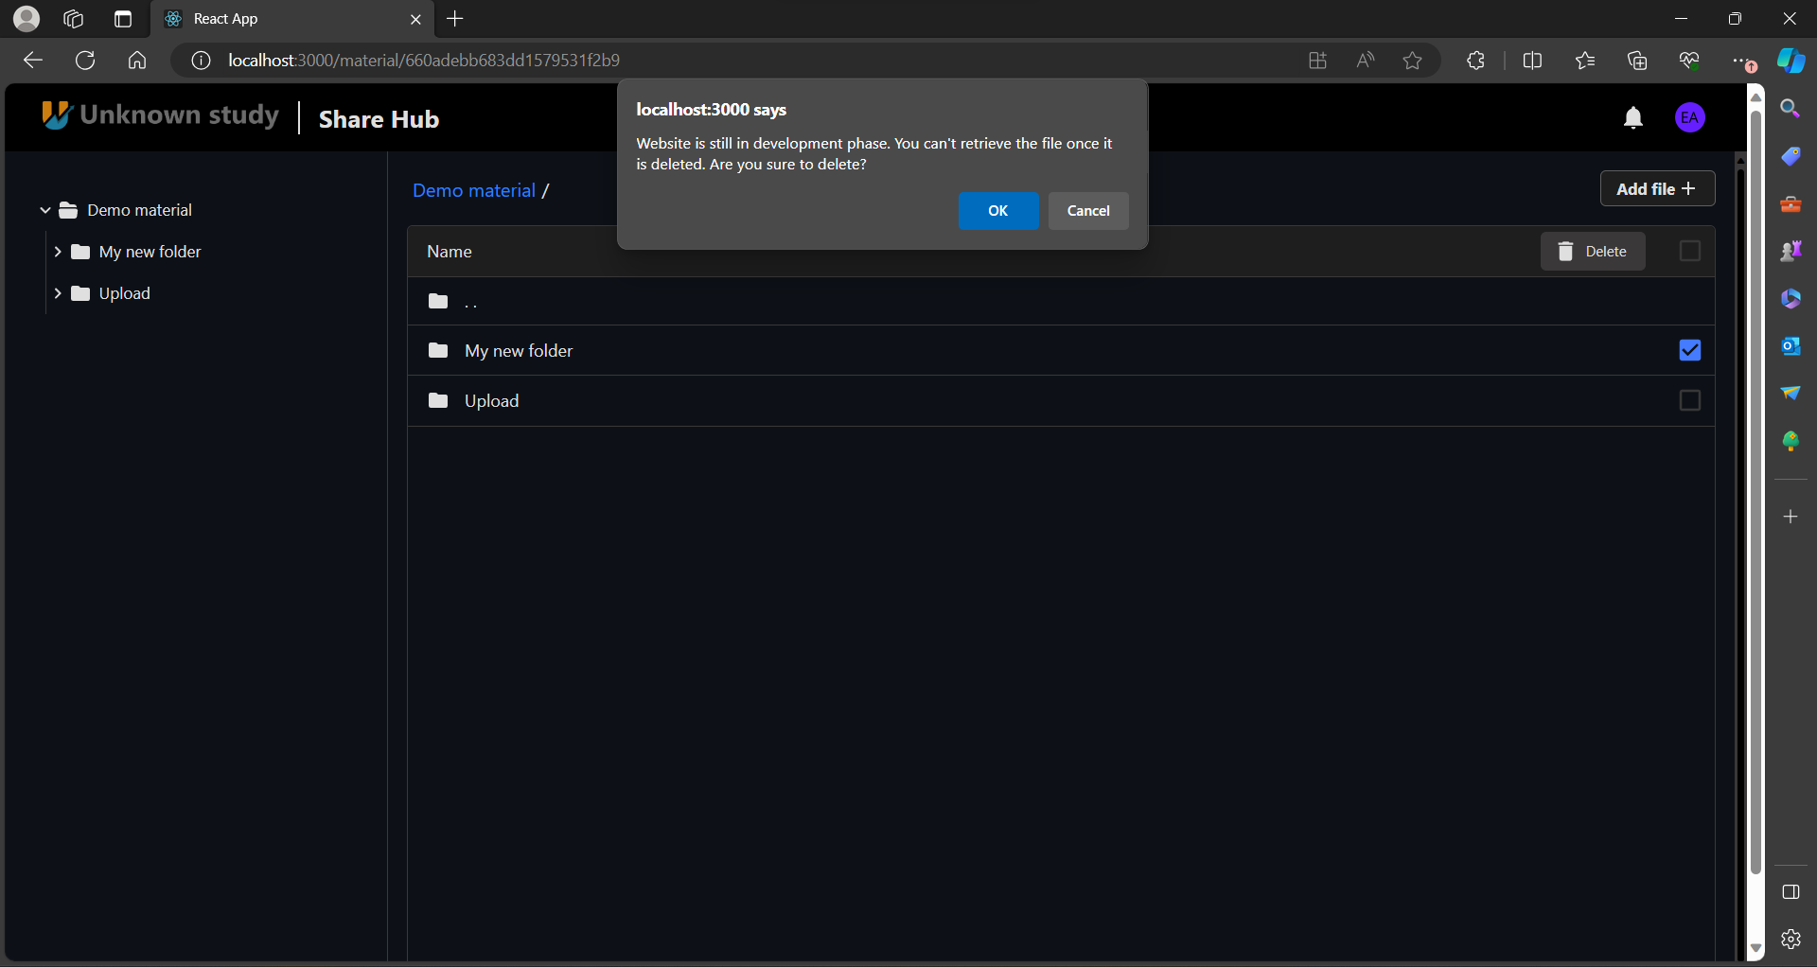

Slide 40
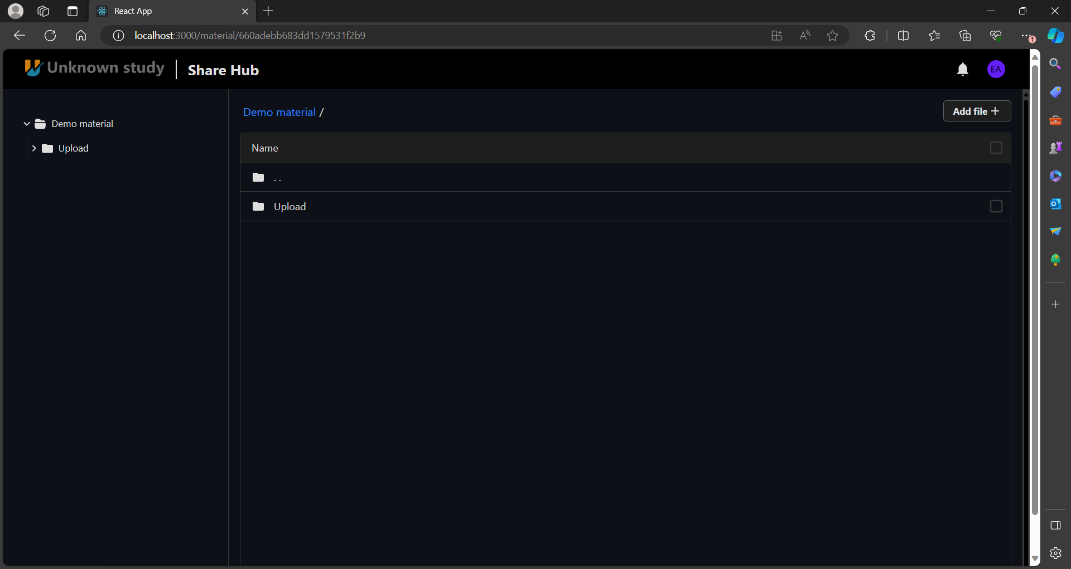

Slide 41
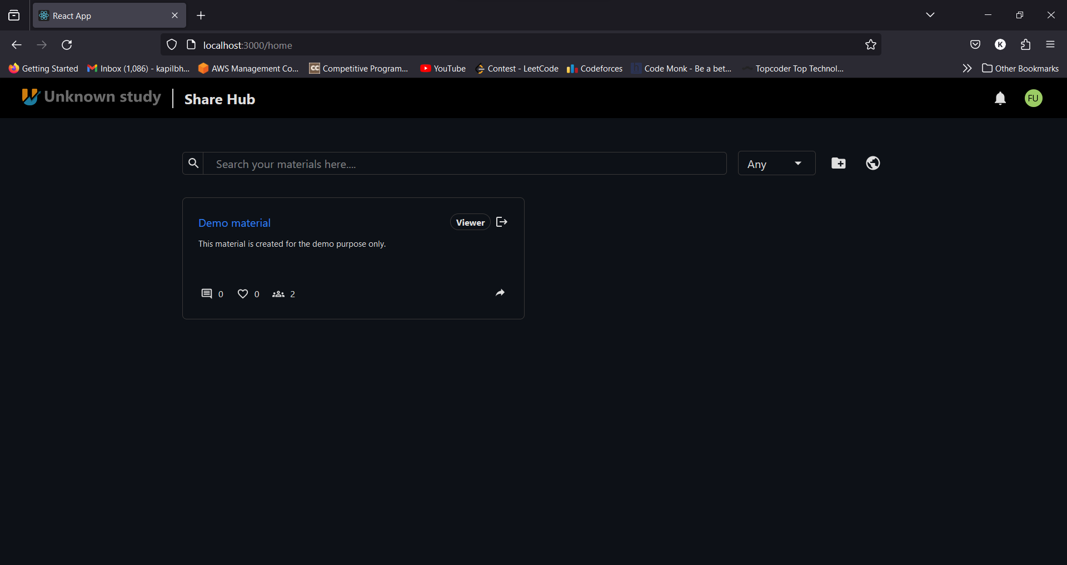

Slide 42
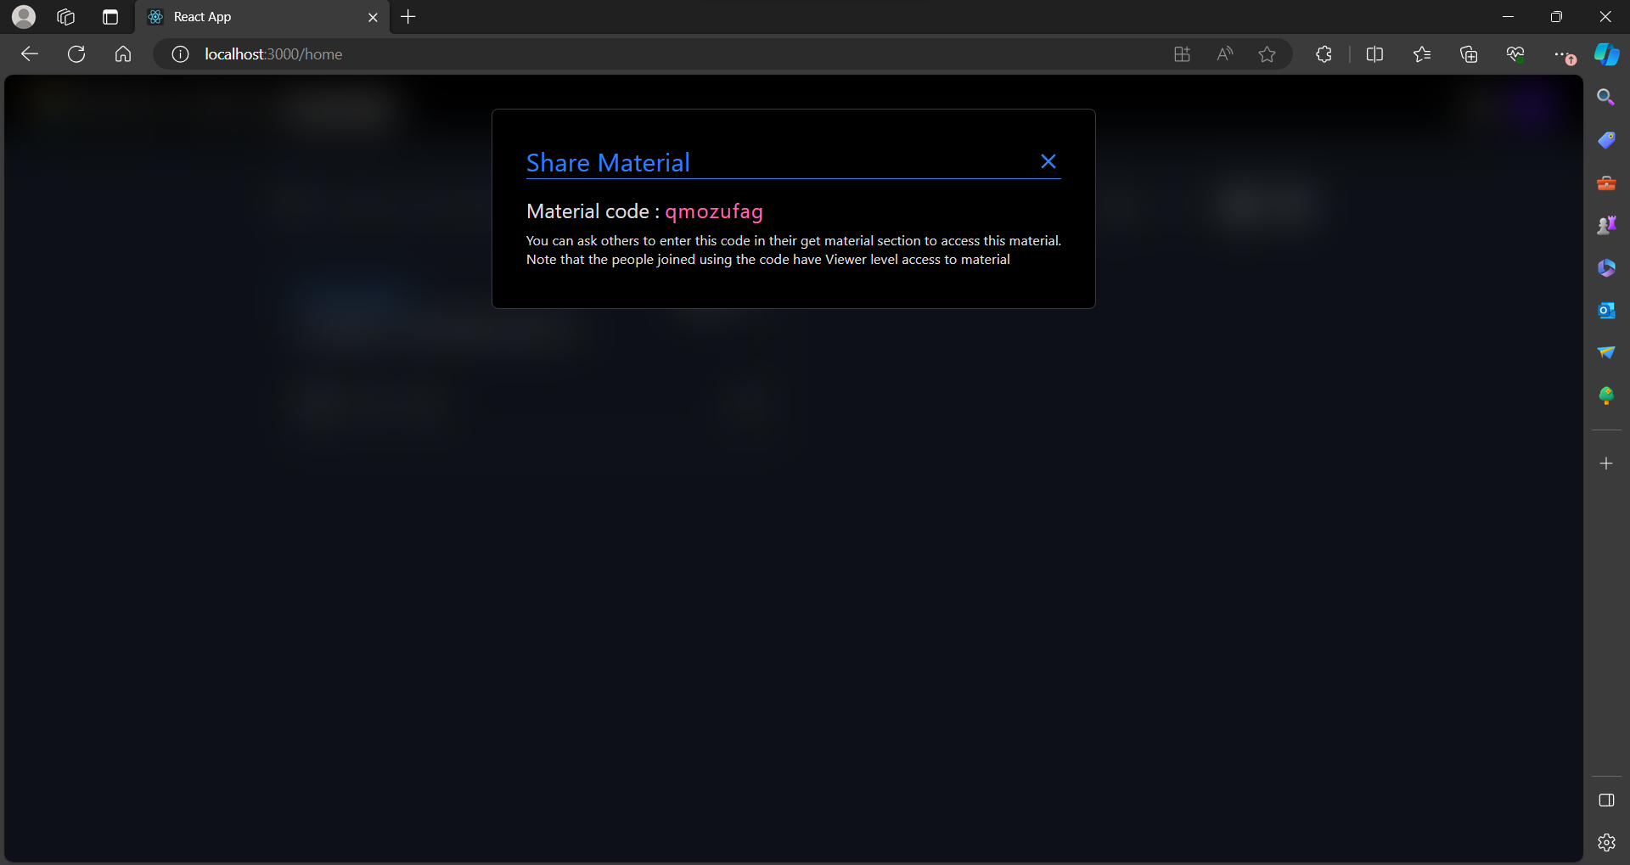

Slide 43
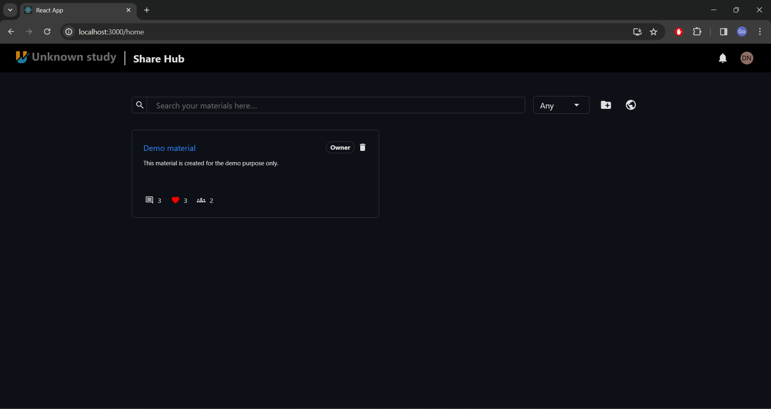

Slide 44
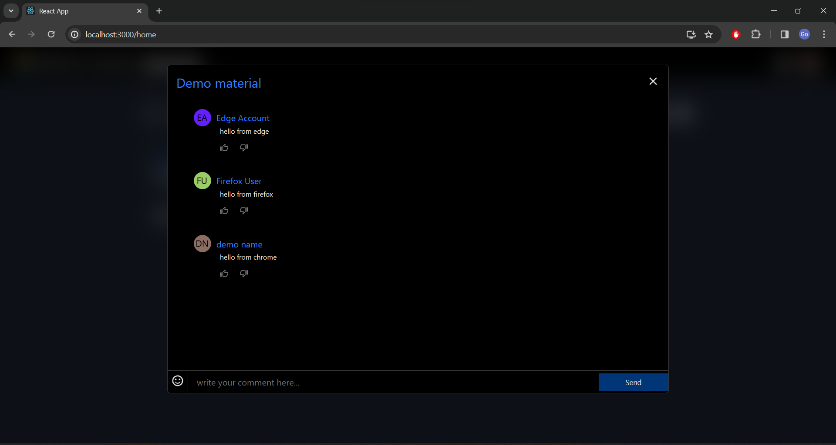

Slide 45
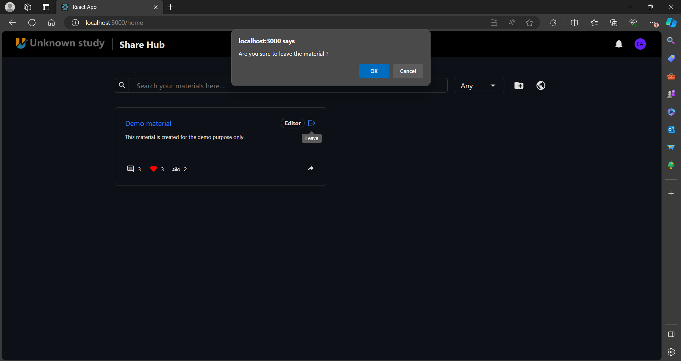

Slide 46
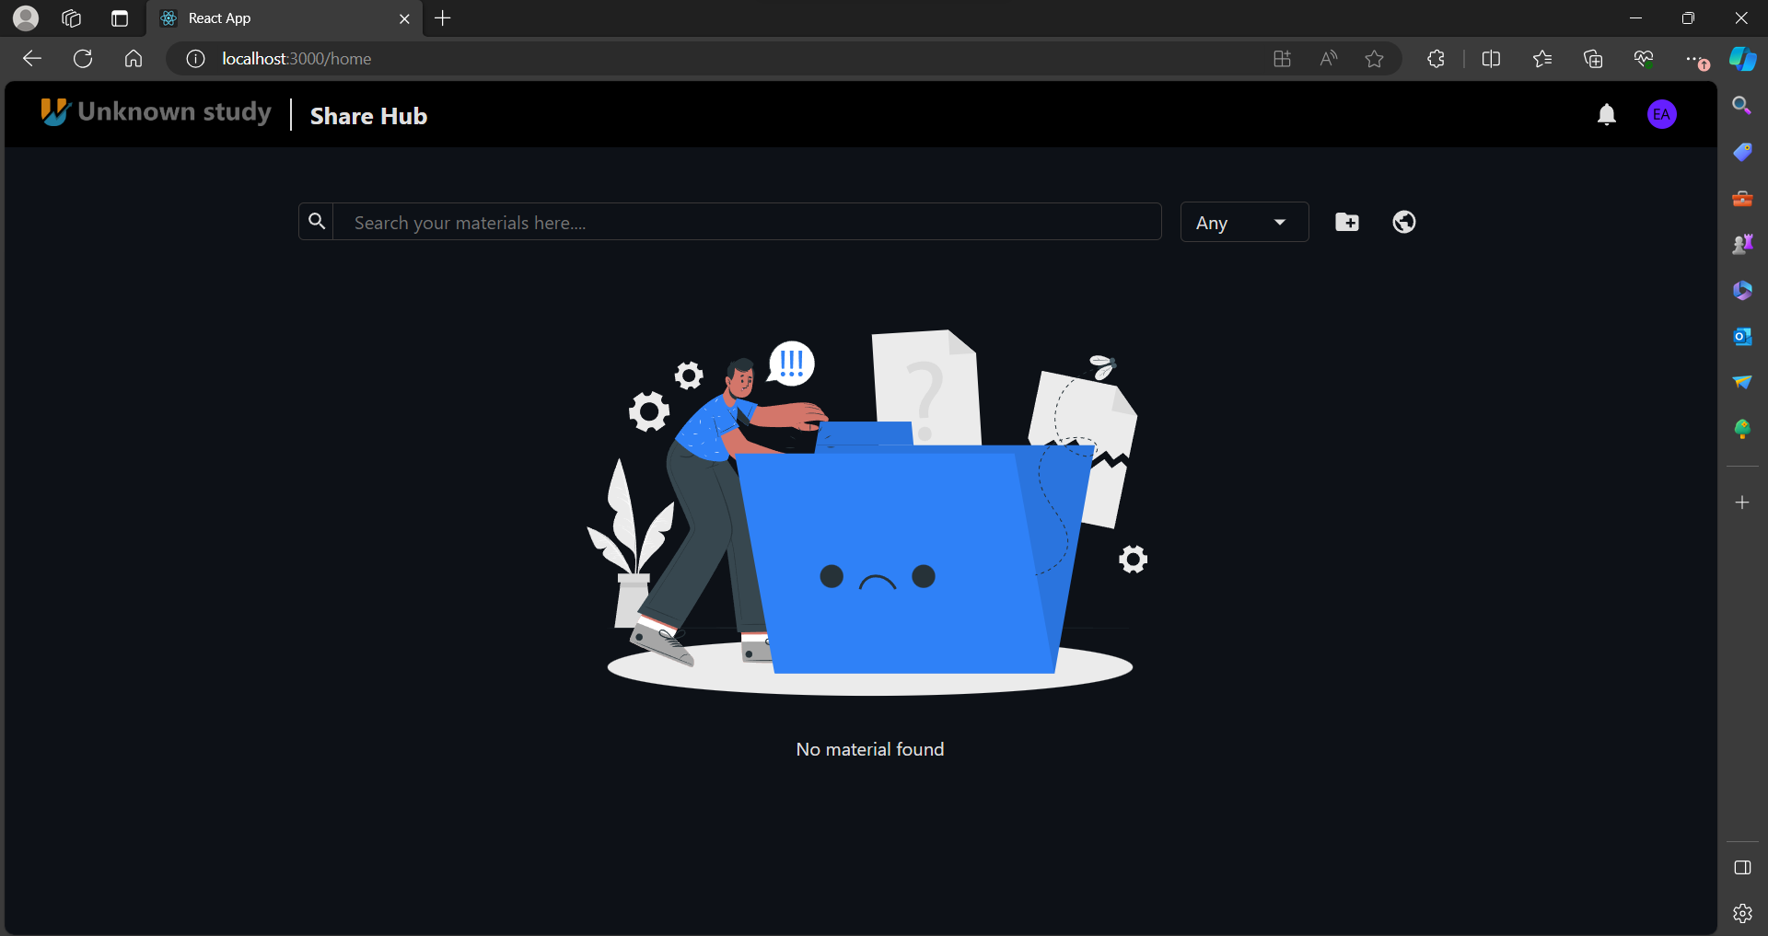

Slide 47
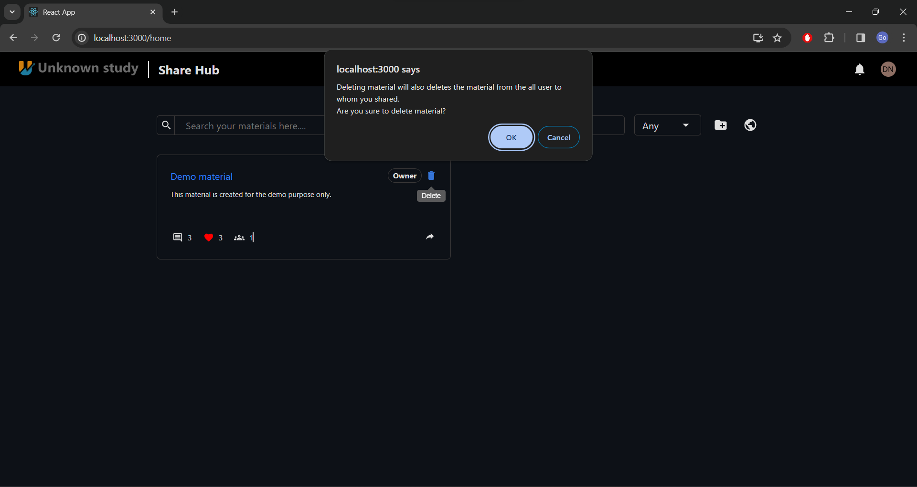

Slide 48
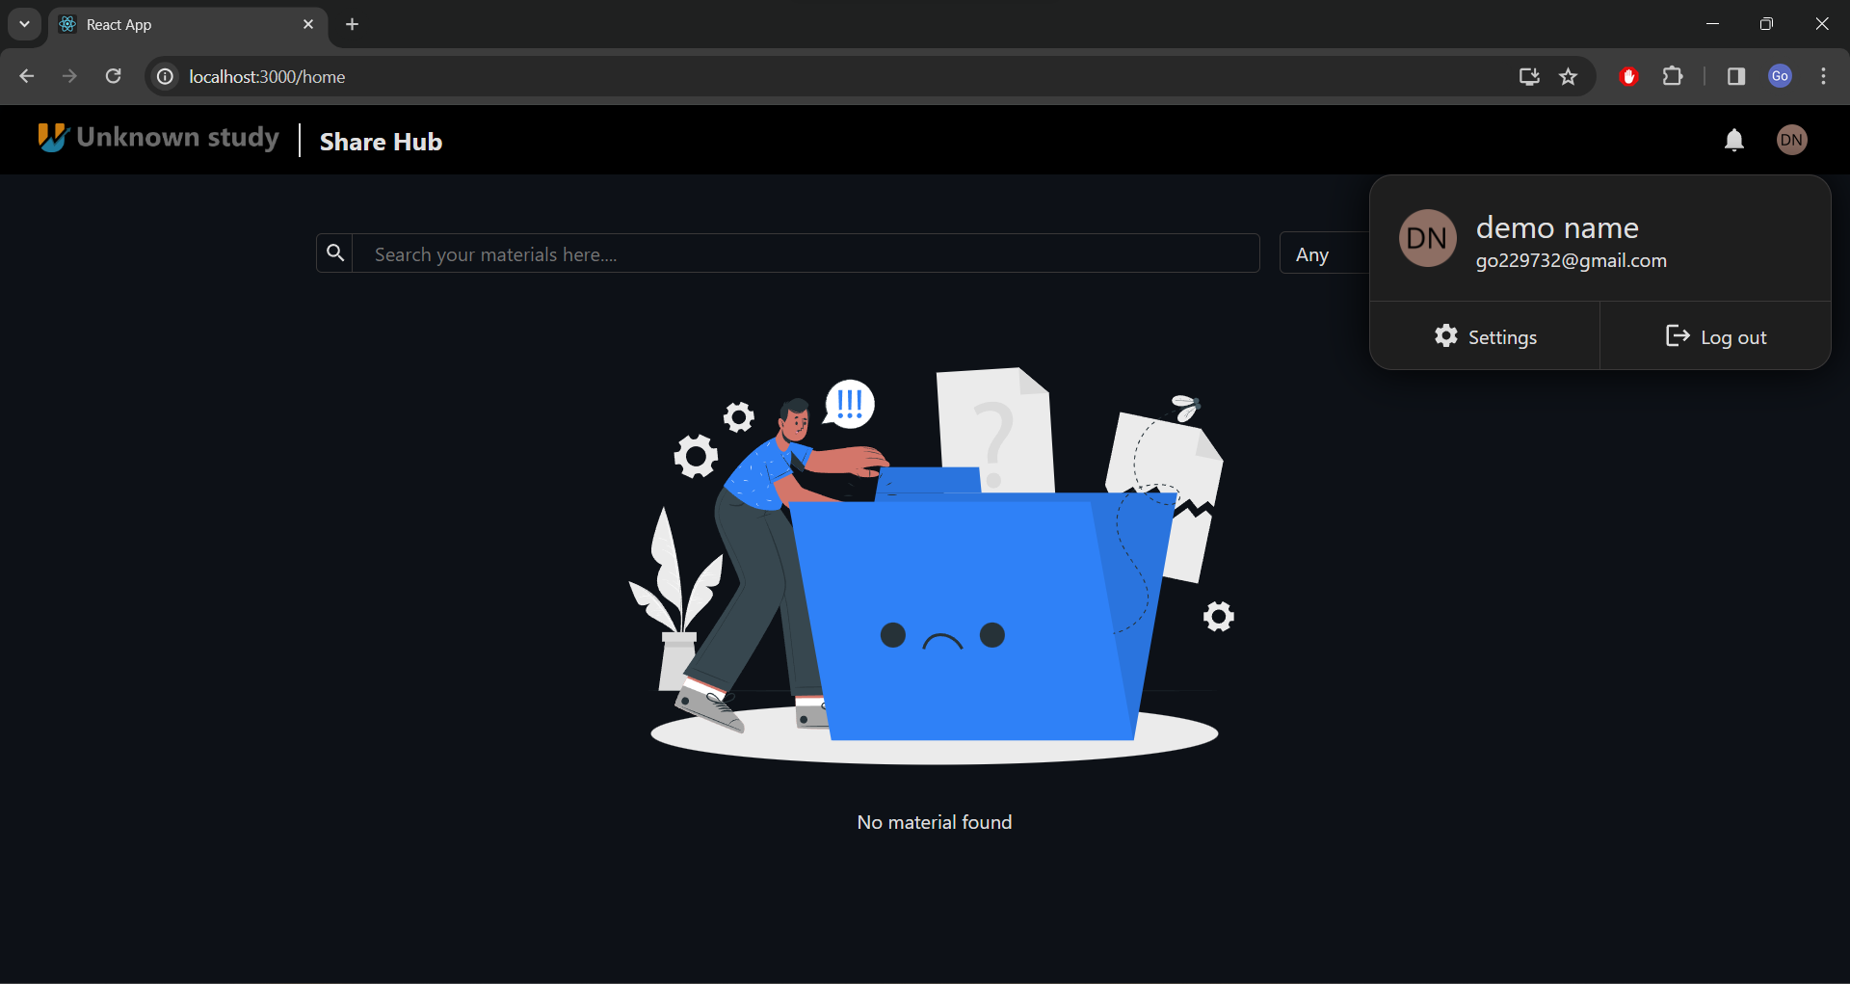

Slide 49
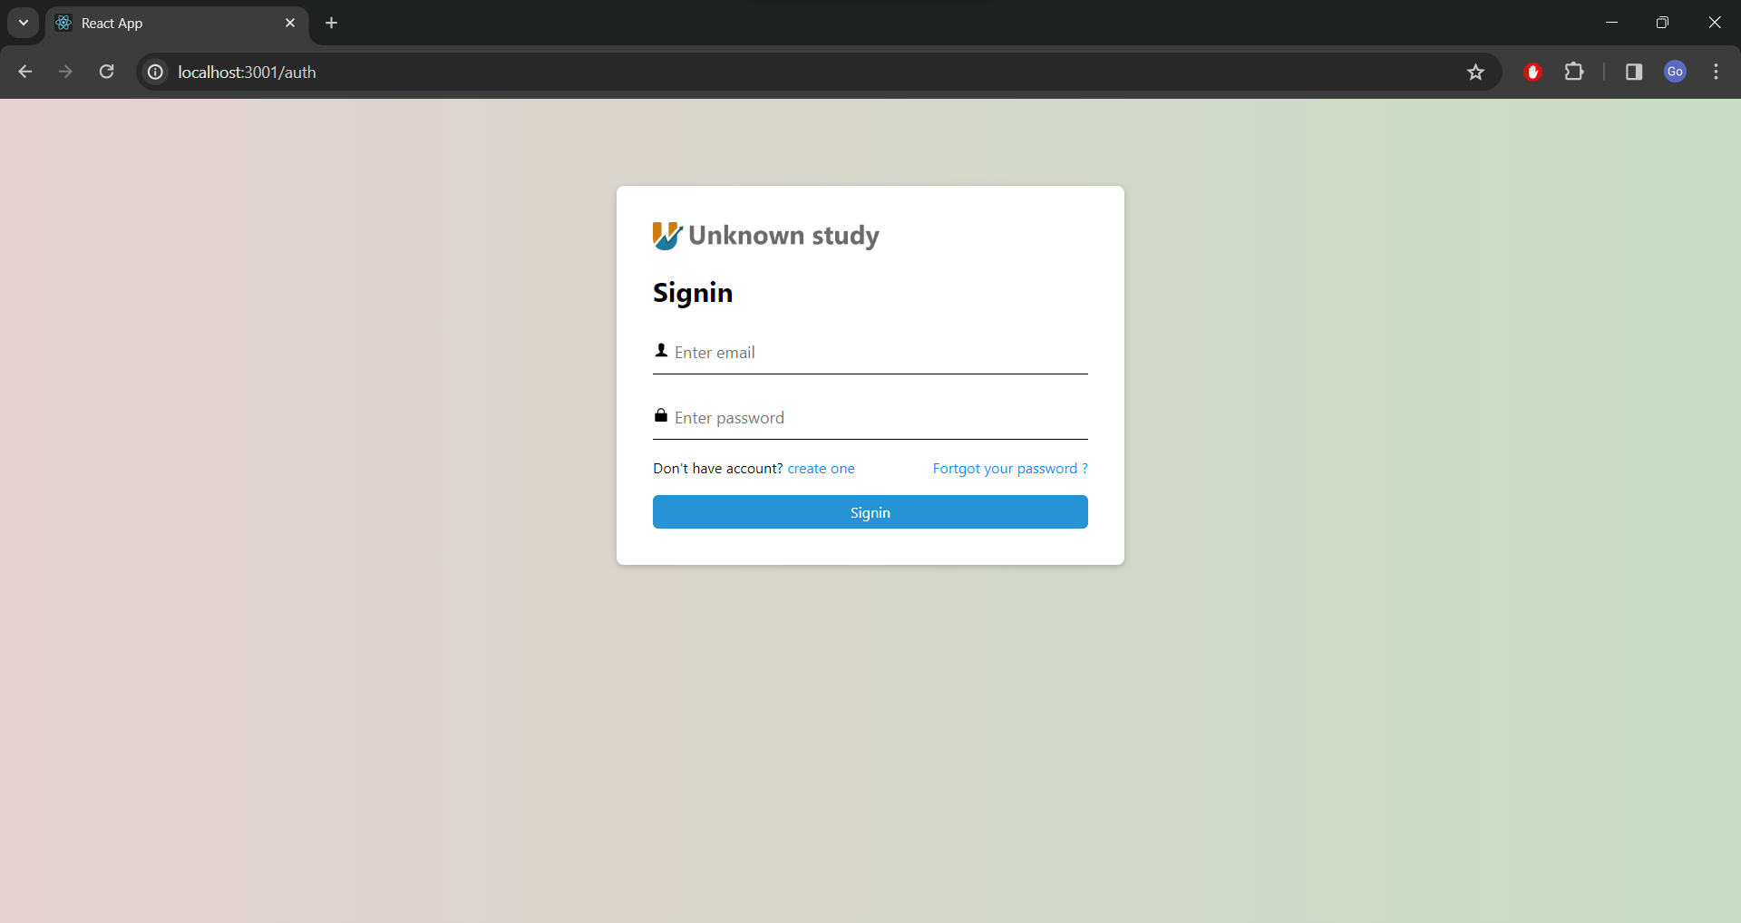

Slide 50
Conclusion
The primary objective of the Share Hub project was to create a robust and user-friendly platform for seamless document sharing.
Leveraging the advantages of the MERN stack technology facilitated rapid development, ensuring that our system met the requirements for speed, efficiency, and scalability.
By utilizing Firebase Storage, a secure and reliable solution for document storage was established, guaranteeing the safekeeping and accessibility of files as needed.
Share-Hub development included essential features like authentication (login, registration, password recovery), document management (upload, download, deletion), and advanced functionalities (material creation, sharing with access control, chat options, like buttons, notifications).
Following thorough testing of the project's functionalities, it is confirmed that the system performs optimally across all specified features.

Slide 51
Limitations
While considerable effort has been devoted to enhancing the Share Hub platform, several
limitations persist, as detailed below:
Limited file relocation functionality
Absence of file renaming feature
Incomplete file information display
Missing option to mark materials as favorites
Lack of recycle bin functionality
Limited file preview support for certain formats
Storage restrictions with Firebase free tier
Lack of storage usage visibility for users
Absence of storage limit management

Slide 52
References
https://firebase.google.com/docs/storage/web/start
https://www.npmjs.com/package/otp-generator
https://www.mongodb.com/languages/express-mongodb-rest-api-tutorial
https://www.mongodb.com/docs/manual/tutorial/query-arrays/
https://sandydev.medium.com/how-to-implement-otp-verification-in-authentication-system-with-express-js-and-mongodb-c4f1c1314aed
https://medium.com/featurepreneur/connect-mongodb-database-to-express-server-step-by-step-53e548bb4967
https://cloud.google.com/appengine/docs/
https://www.freecodecamp.org/news/simplify-your-file-upload-process-in-express-js/
https://www.w3schools.com/react/react_usecontext.asp

Slide 53
Thank You

